Slide 1
Aqara Motion Sensor P1 Introduction

Slide 2
Content
Product introduction
Product installation
Configuration on App
FAQ

Slide 3





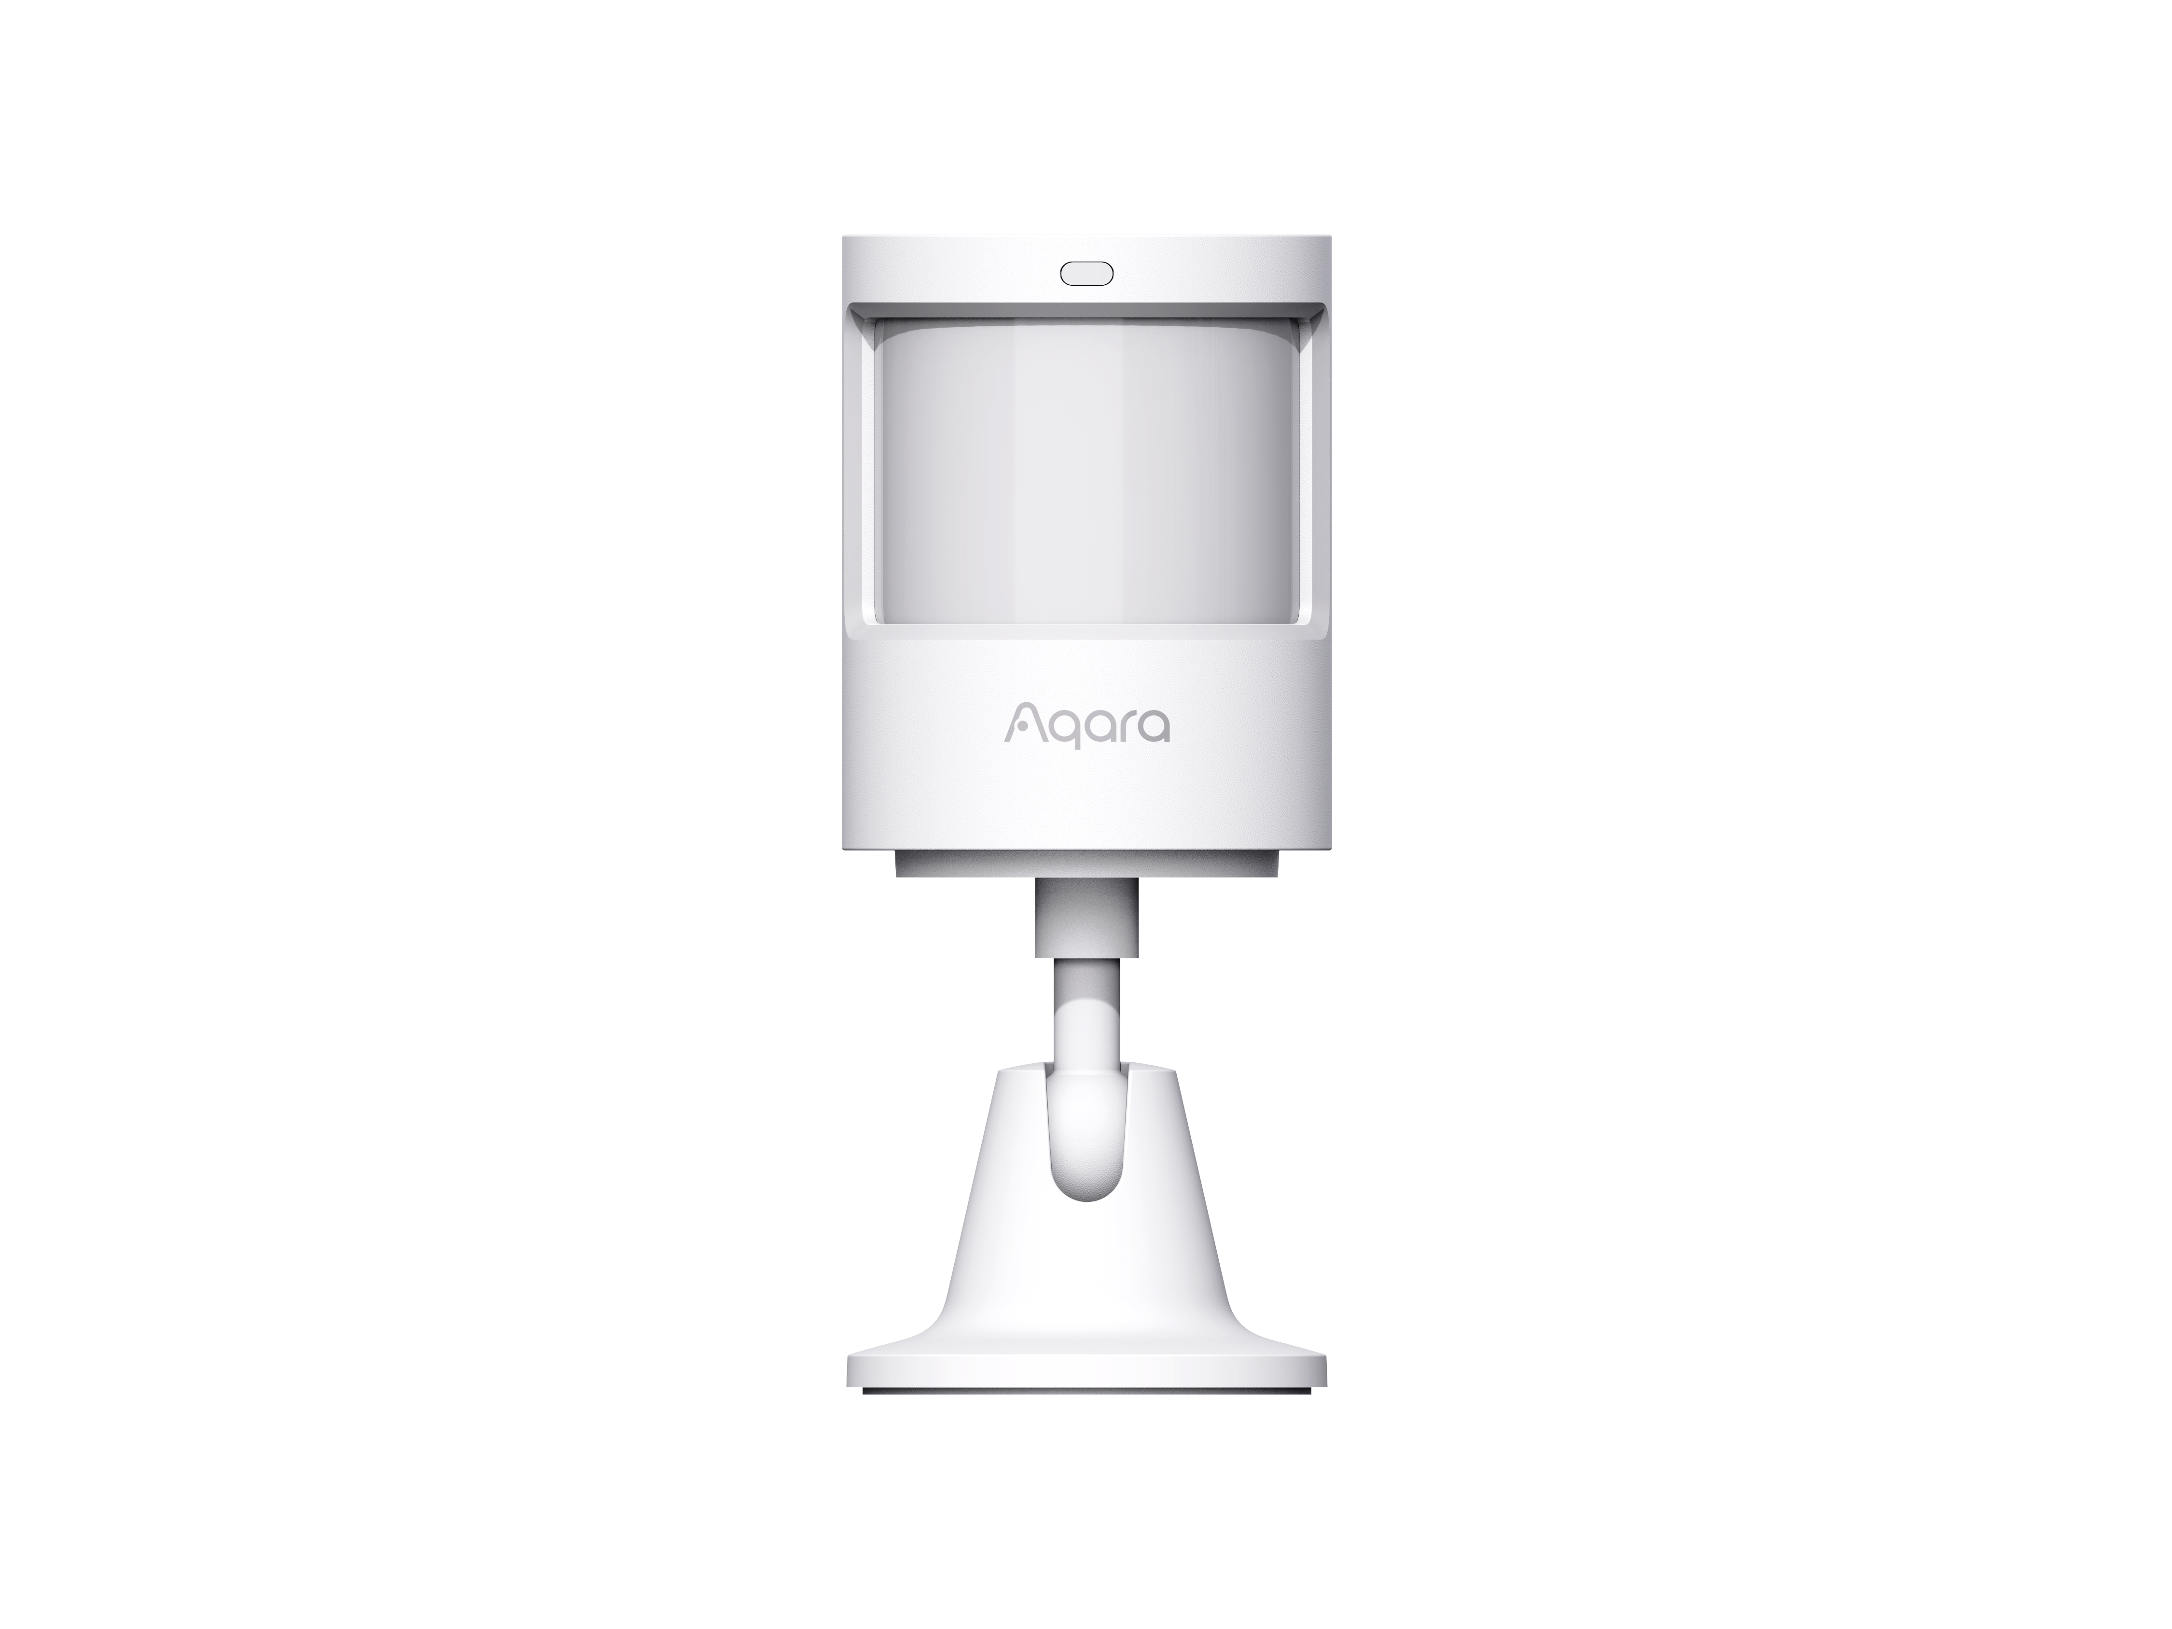
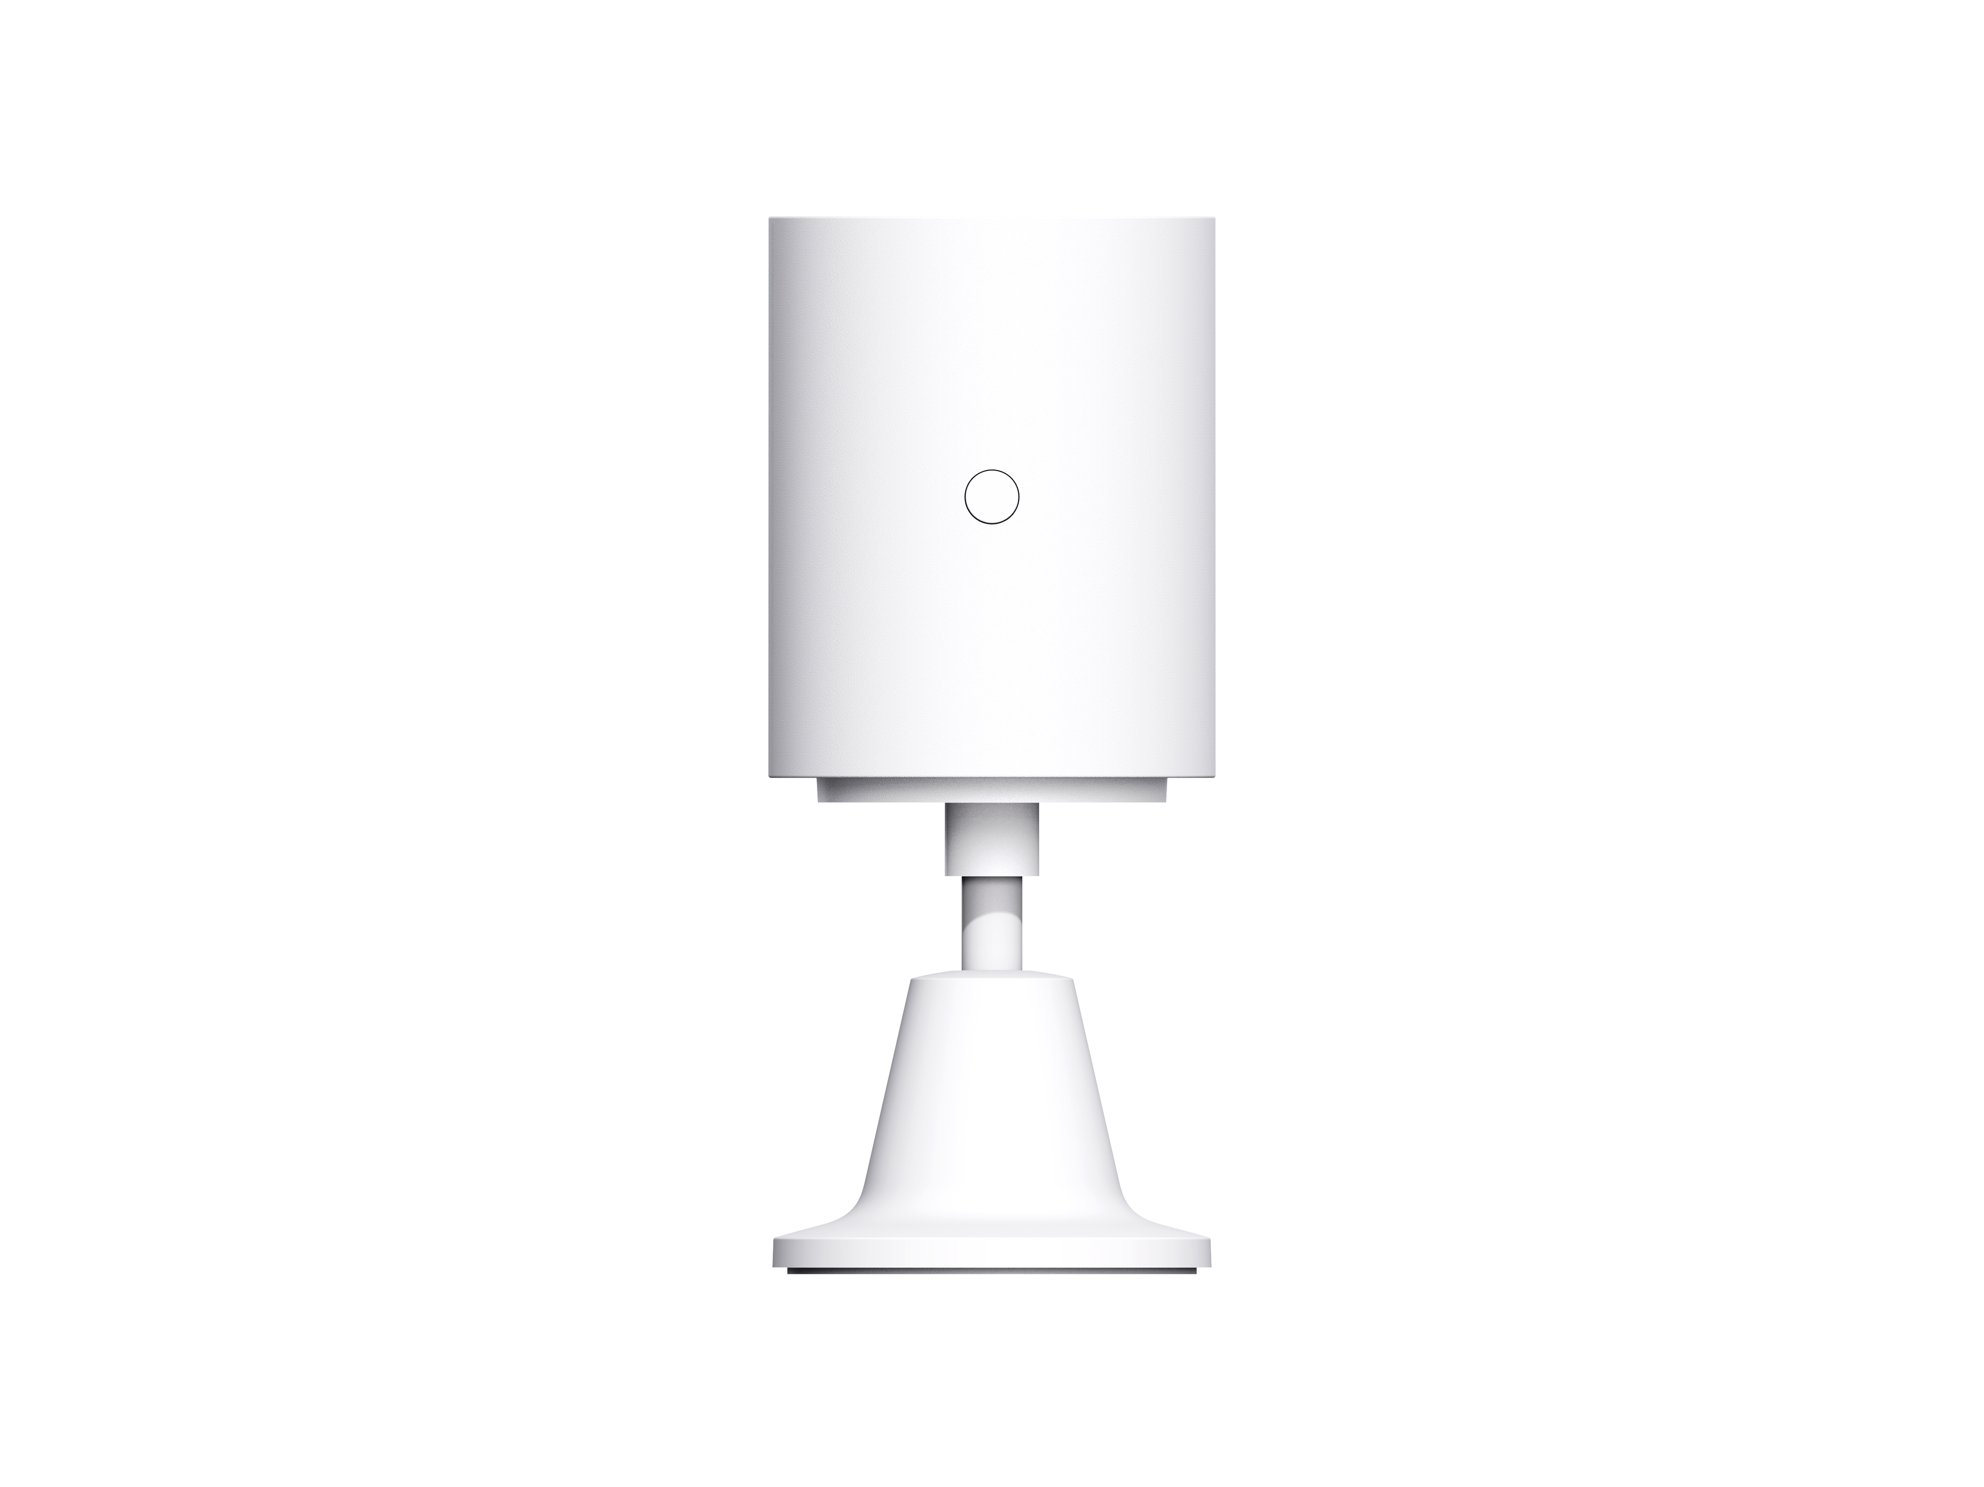
Product Profile
Motion Sensor P1 detects body motion and the state of ambient light. If there are any people moving or any change in the ambient light state in the areas under detection, the motion sensor will send notice to the Aqara Home app through the connected Aqara Zigbee 3.0 Hub or link to other devices.
Built-in light
sensor
Configurable
detection timeout
Adjustable sensitivity
Five-year
battery life
Up to 170°
filed of view
Indicator light
Fresnel lens
Reset button
Stand
Front view
Back view
*This product is for indoor use only. Please bind the product to the Hub before use.
*Aqara Hub is required to enable Aqara Motion Sensor P1 to work with Homekit.

Slide 4
Motion Sensor Usages
Put it in the living room
Usage 1: Home security
With the Motion Sensor, you can turn on alarm mode when you leave the house. If it detects movement, the Hub will sound an alarm and send a notification to your phone.

Slide 5
Motion Sensor Usages
Put it in the kitchen/bathroom/staircase
Usage 2: Automatically turns lights on or off
Motion sensor works with other smart accessories to set various scenes, such as turning on or off lights automatically when it detects activity or inactivity

Slide 6
Product Selling Points
170-degree motion detection
Smart Control in Apple Home App
Easy and flexible installation methods
You will be able to use the stock ultra-wide angle of the sensor or limit it using any obstacle or a regular electric tape.
Works with other HomeKit-enabled accessories in Apple Home app to make your life easier.
No tools required for installation. With a sensor stand and sticker, you can set the motion sensor wherever you want. The stand can make a 360 rotation and you can easily adjust the detection angle.
Remote security notification
Advanced Technology
With the Motion Sensor, you can turn on alarm mode when you leave the house. If motion is detected, the Hub will sound an alarm and send a notification to your phone.
A Japanese infrared sensor is used to detect human motion through the moving heat source and the US Polyolefin Fresnel lens is used for high precision detection. The shell is made of anti-UV material and the colour will not fade allowing for long-term usage. The high quality flame-retardant material is used to improve safety.

Slide 7
Product Specifications
Basic Parameters
Wireless Parameters
Category | Description
Model | MS-S02
Dimensions | 33.1× 33.1× 41.6mm
Color | White
Material | PC + ABS
Battery | CR2450
Package Box Size | 55× 37× 70 mm
Carton Size | 410× 336× 278mm
Product Weight | 33g
Detection Angle | ≈150°(max 170°)
Detection Distance | ≈7m
Category | Description
Wireless Protocol | Zigbee 3.0
Wireless Standard | IEEE 802.15.4
Wireless Frequency | 2.4 GHz (2400～2483.5 MHz)
Wireless Transmit Power | ＜10 dBm
Receiving Sensitivity | -96dBm
Communication Distance | 30m (Indoor)
Electrical Parameters
Environment Parameters
Category | Description
Input Voltage | 3V
Battery Capacity | 1240mAh
Battery Life | 5years
Category | Description
Operating Temperature | -10 ℃ ～ +55℃
Storage Temperature | -25 ℃ ～ +70 ℃
Operating Humidity | 0 ~ 95% RH, no condensation

Slide 8
Button Functions
Reset button
Long press for 5s: Reset/Add the device;
Single press: Effective range test/Device identify;
Effective range test: When single press the reset button, the Hub will make voice prompt of “Normal link confirmed” , it means the connection between the device with Hub is normal.
Device identify: When single press the reset button, the device will flash on the app at the menu of Accessories.

Slide 9
Content
Product introduction
Product installation
Configuration on App
FAQ

Slide 10
Product Installation
Option 1: Direct installation
1. Choose an appropriate installation position and make sure the installation surface is clean and flat.
2. Put the sticker on the bottom of the battery cover, determine the detection direction, stick it to the desired installation position, and press hard and evenly for 30 s to make sure it sticks firmly.

Slide 11

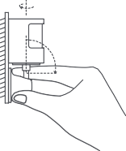
Product Installation
Option 2: Installation with holder
1. Choose an appropriate installation position and make sure installation surface is clean and flat.
2. Stick the sensor to the installation pedestal, and press hard and evenly for 30s to make sure it sticks firmly.
3. Stick holder pedestal in the required area, and press hard and evenly for 30s to make sure it sticks firmly. In the case of installing on a wall surface, it is recommended that the holder gap faces upward to facilitate adjusting detection direction.

Slide 12
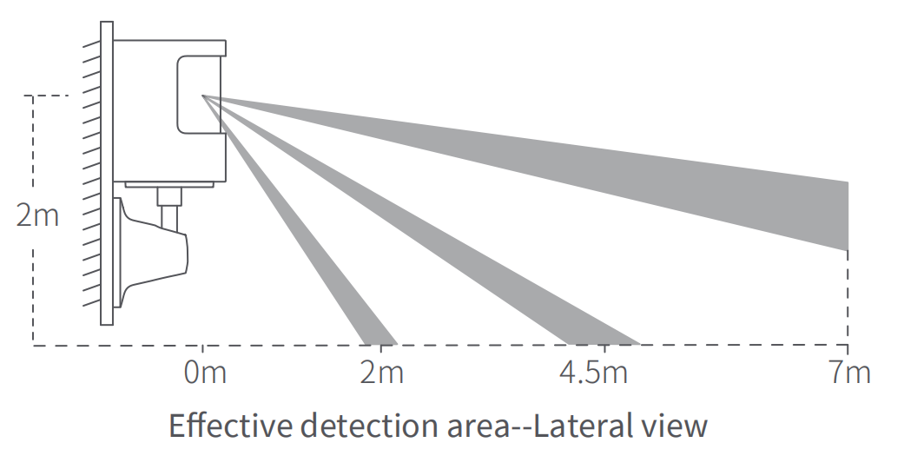
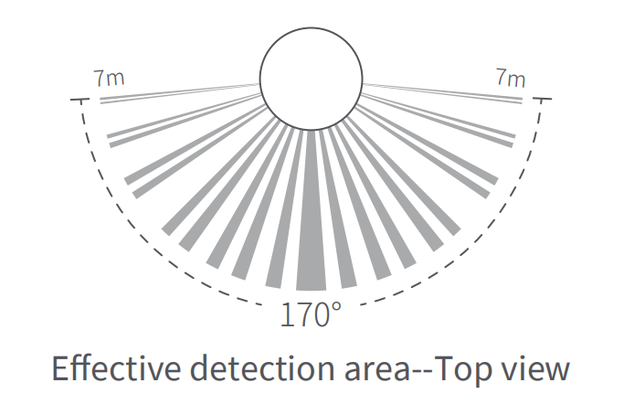
Installation Instruction
1. Please do not install on tile, glass, marble, or other smooth and easy-to-moisten objects to avoid the sticker from loosening.
2. Please do not install on the surface of a lighting tube or other high-temperature and heating objects to avoid the sticker from loosening.
3. Please do not install on the surface of wall coverings and other rough and uneven objects to avoid the sticker from loosening.
4. Please do not face it against electrical appliances and other heating sources to prevent infrared jamming from causing a false trigger.

Slide 13
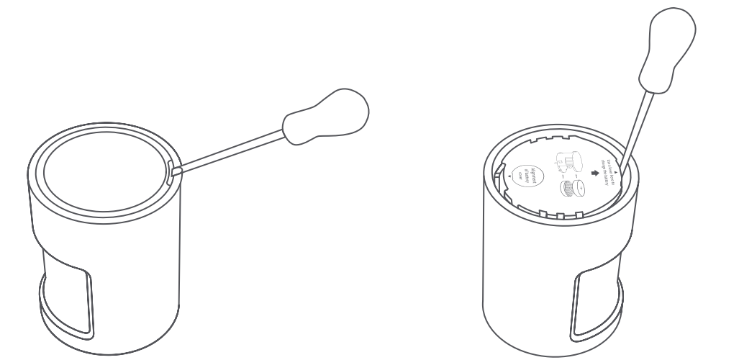
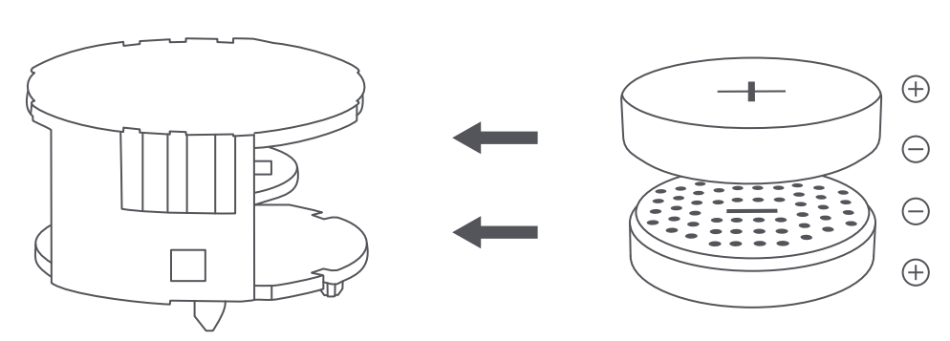
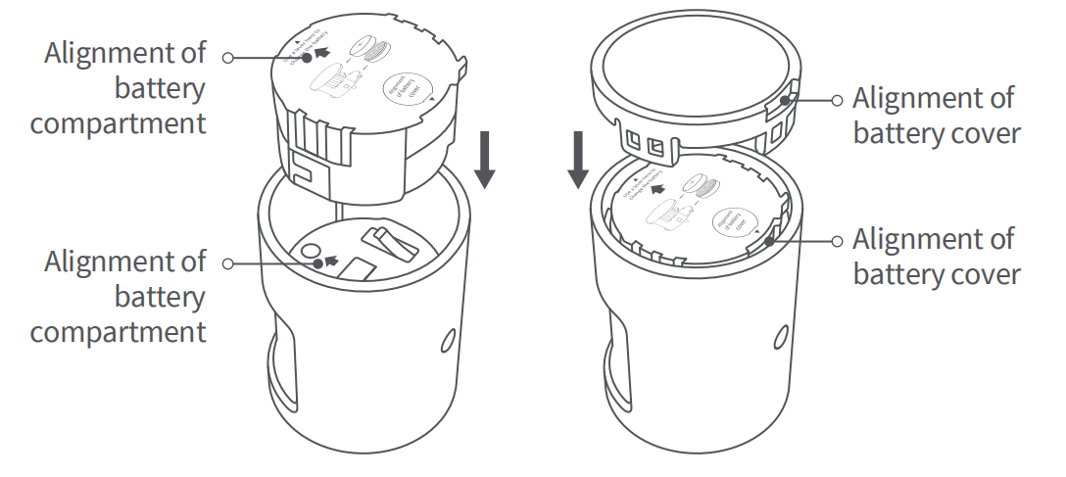
Battery Replacement
1.Take off the battery cover from its gap with screw driver, and stretch the screw driver into battery compartment lever opening and take off the battery compartment.
2.Install two brand-new CR2450 button batteries into the battery compartment, with one firmly sticking the compartment top on the polar front and the other firmly sticking to the compartment bottom on the polar front.
3.Align to and install the battery compartment based on arrow directions, and then put on the battery cover.

Slide 14
Content
Product introduction
Product installation
Configuration on App
FAQ

Slide 15
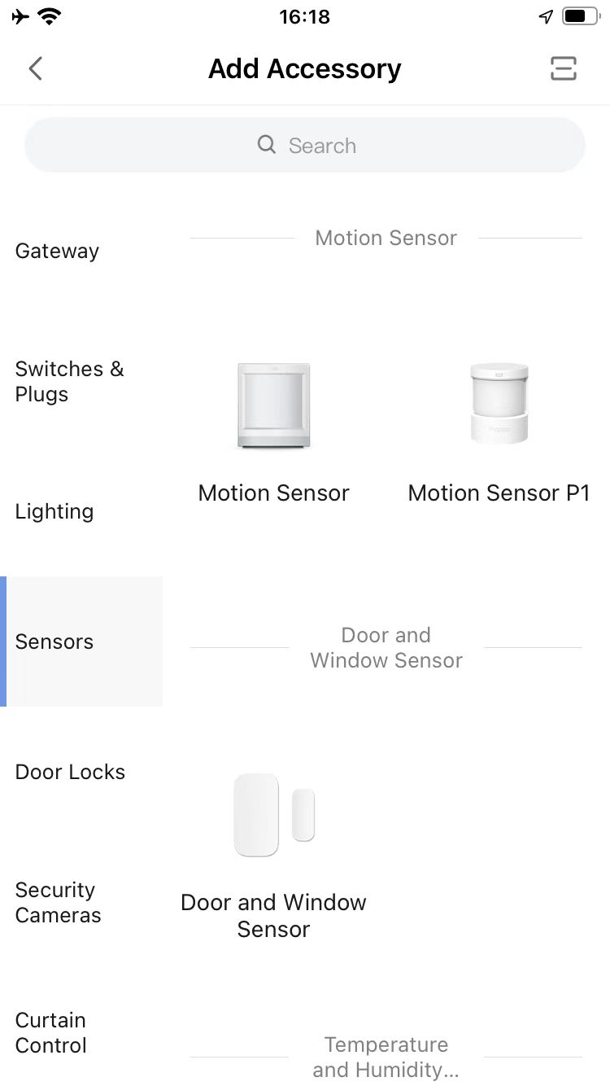
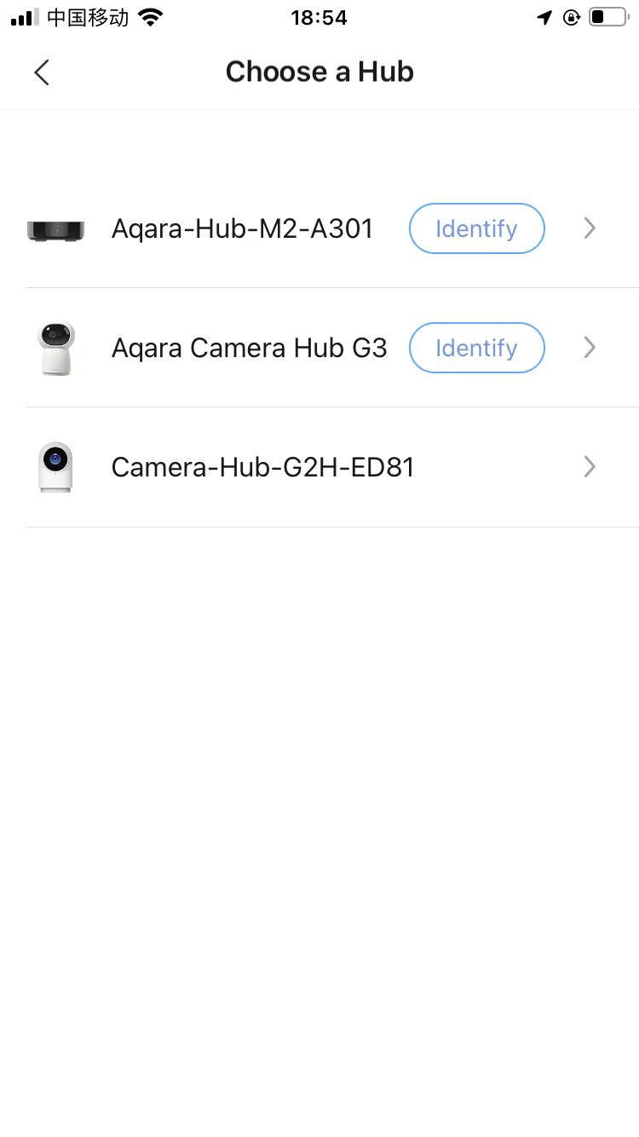
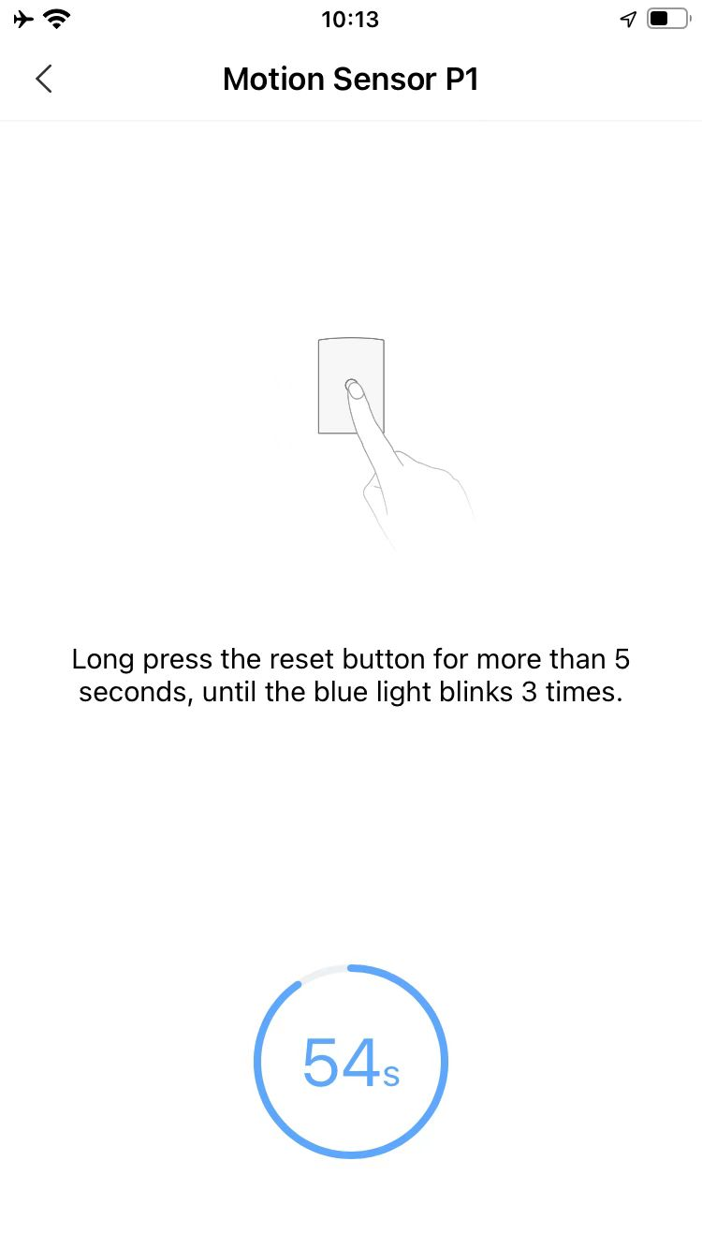
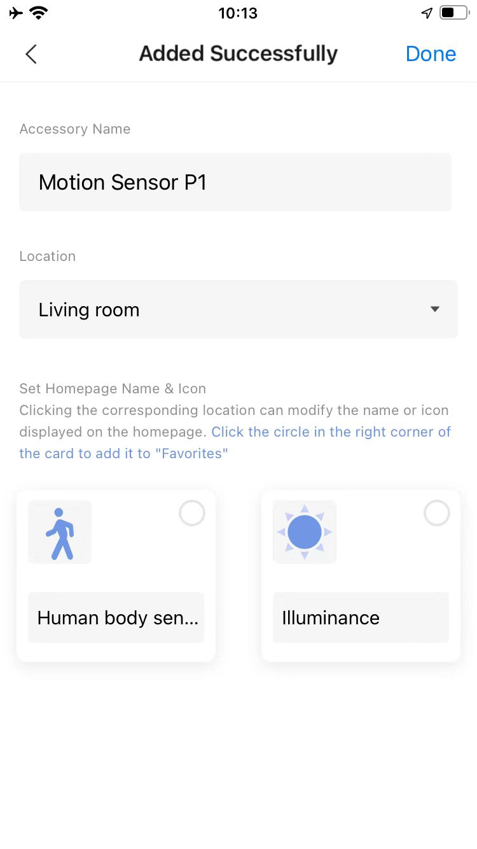
How to Bind Motion Sensor P1 on App
Open the app, enter “Add Accessory” and select “Motion Sensor P1” .
Choose a Hub. Please complete the hub binding before selecting a hub here.
Press and hold the reset button for more than 5s, until the blue light blinks 3 times.
Click “Done” to complete the device binding.
1
6
3
4
5
2

Slide 16
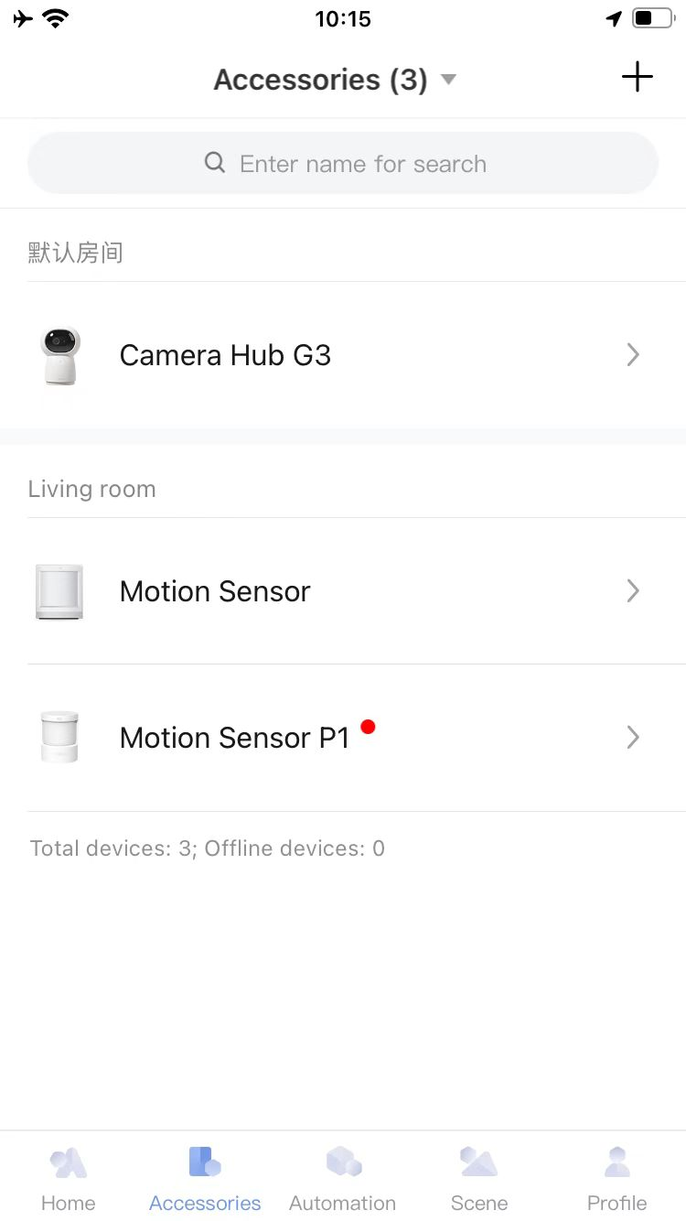
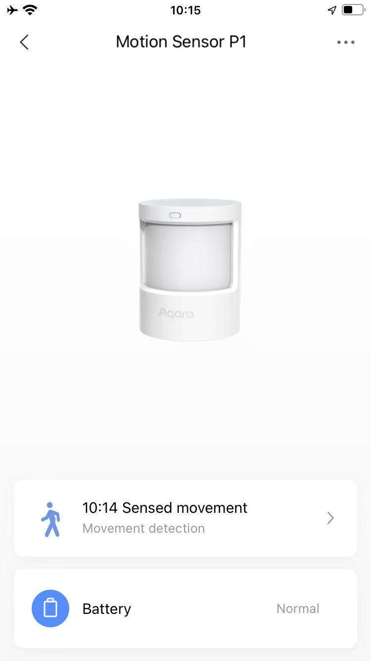
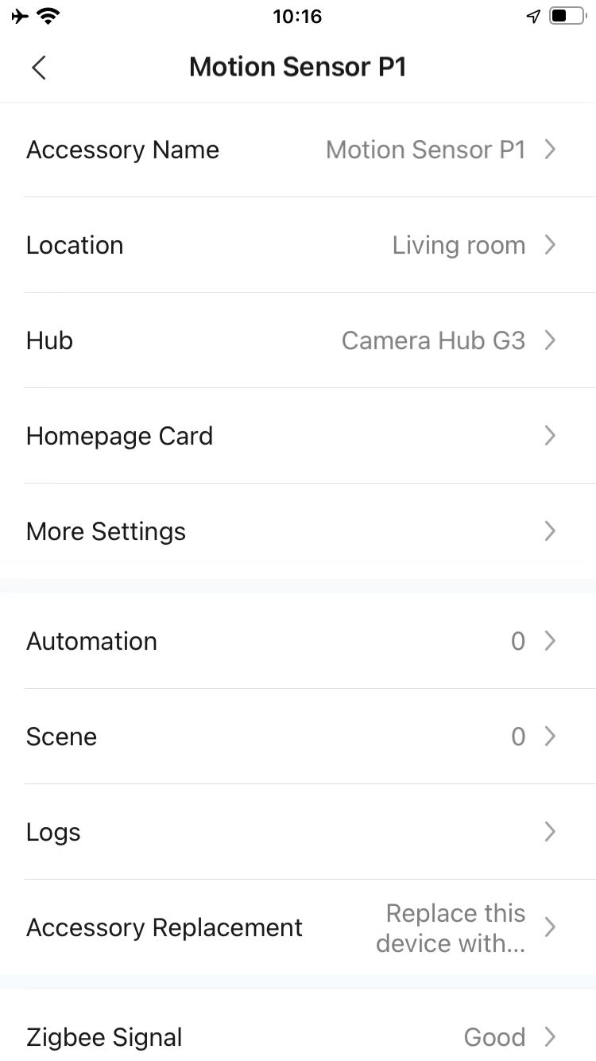
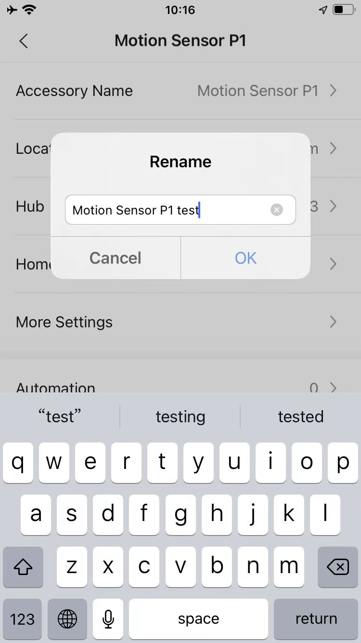
How to Rename the Device
Open the app, enter “Accessories” and select “Motion Sensor P1” .
Click “...” .
Click “Accessory Name” .
Input new name and click “OK”.
2
3
4
1
*Once rename the device, the new name will display at the menu of “Accessories” on App.

Slide 17
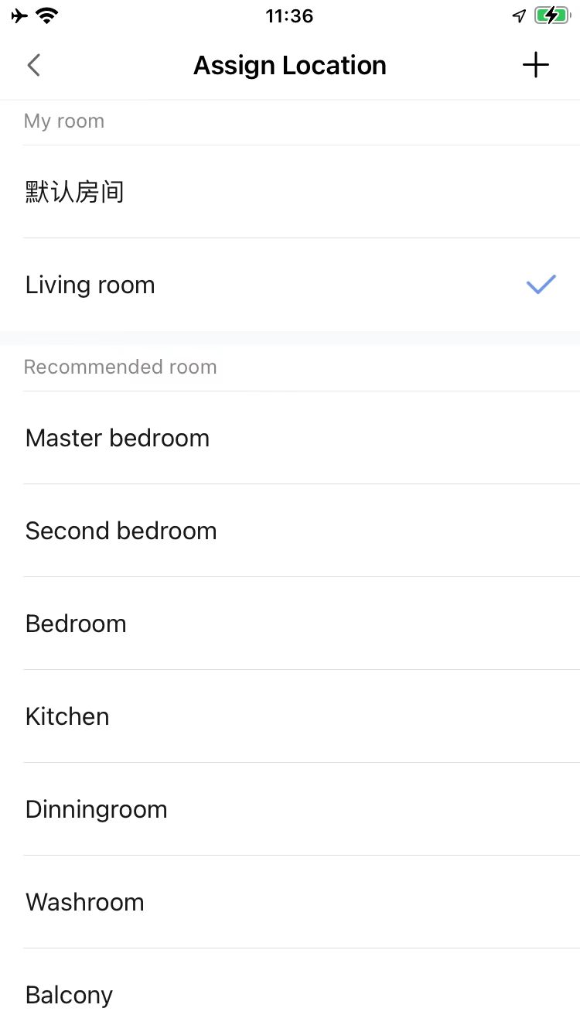
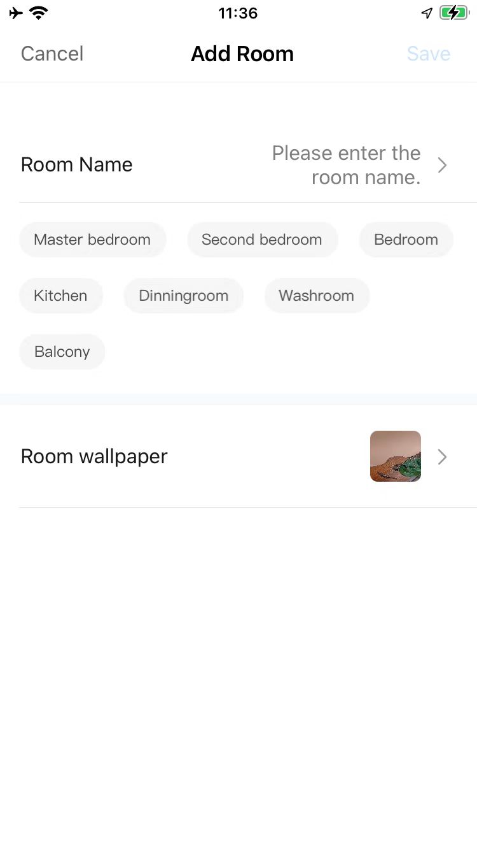
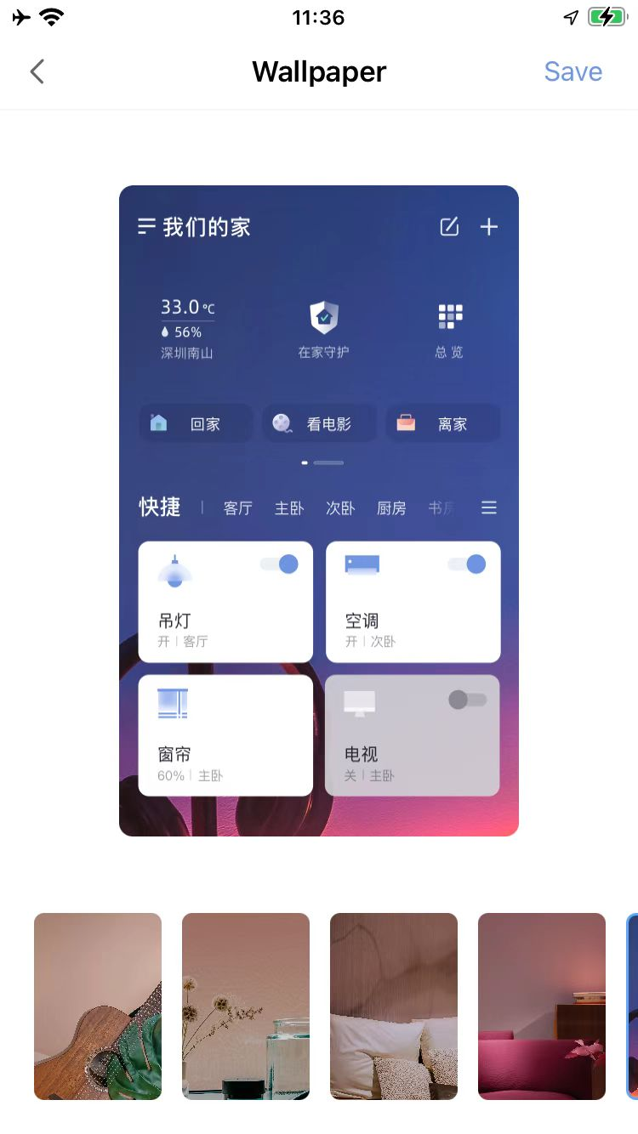
How to Set Location
select the location: Step 1--Step 2;
Create new location: Step 1--Step 3--Step 4--Step 5, or you can select the name in the list here;
Select the wallpaper: Step 1--Step 3--Step 6--Step 7.
3
5
7
4
1
6
2

Slide 18
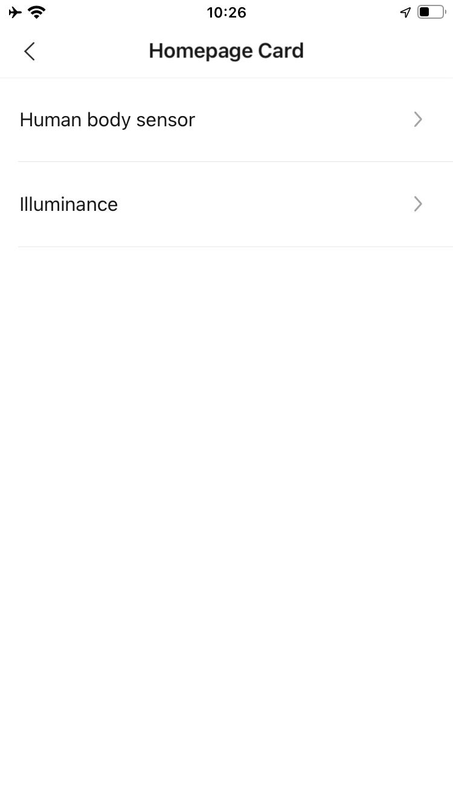
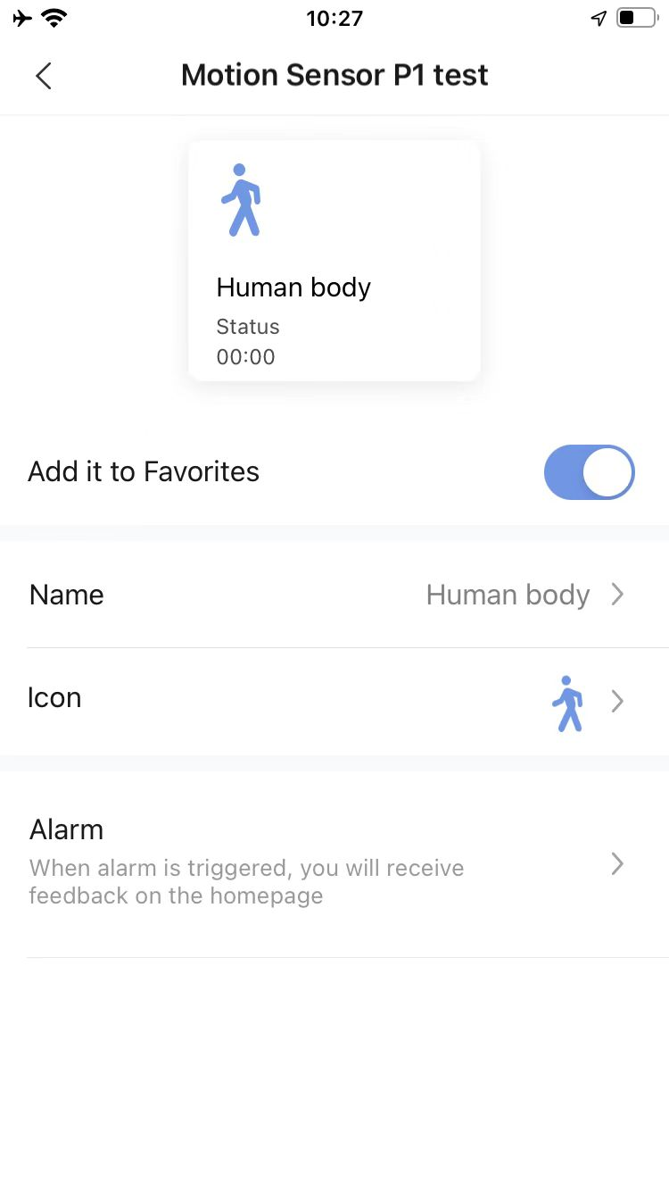
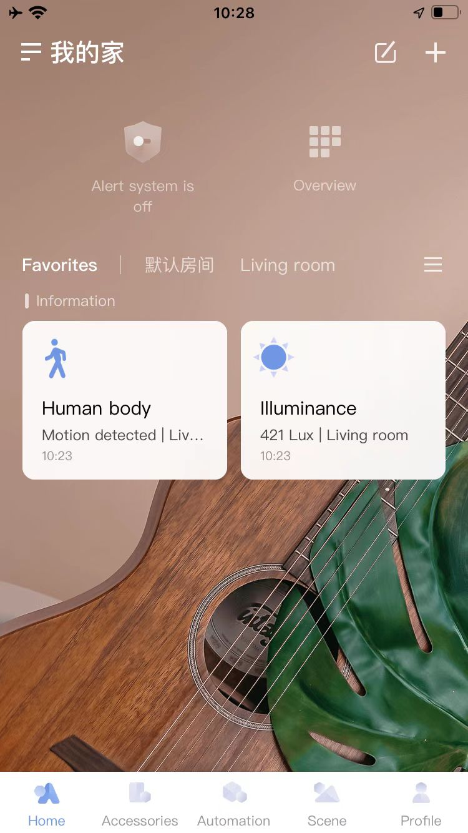
How to Add Device to “Favoriate” on Homepage
Open the app, enter “Motion Sensor P1” . Then click ”Homepage Card”.
Select “Human body Sensor” or “Illuminance”
Enable “Add it to Favorites”,
Give the new name on the homepage for device as per requirement.
Go to the homepage and click “Favorites”. The device will display here.
2
6
1
3
7
4
5
*Once give the new name at step 3, the new name will display at “Favoriate”.

Slide 19
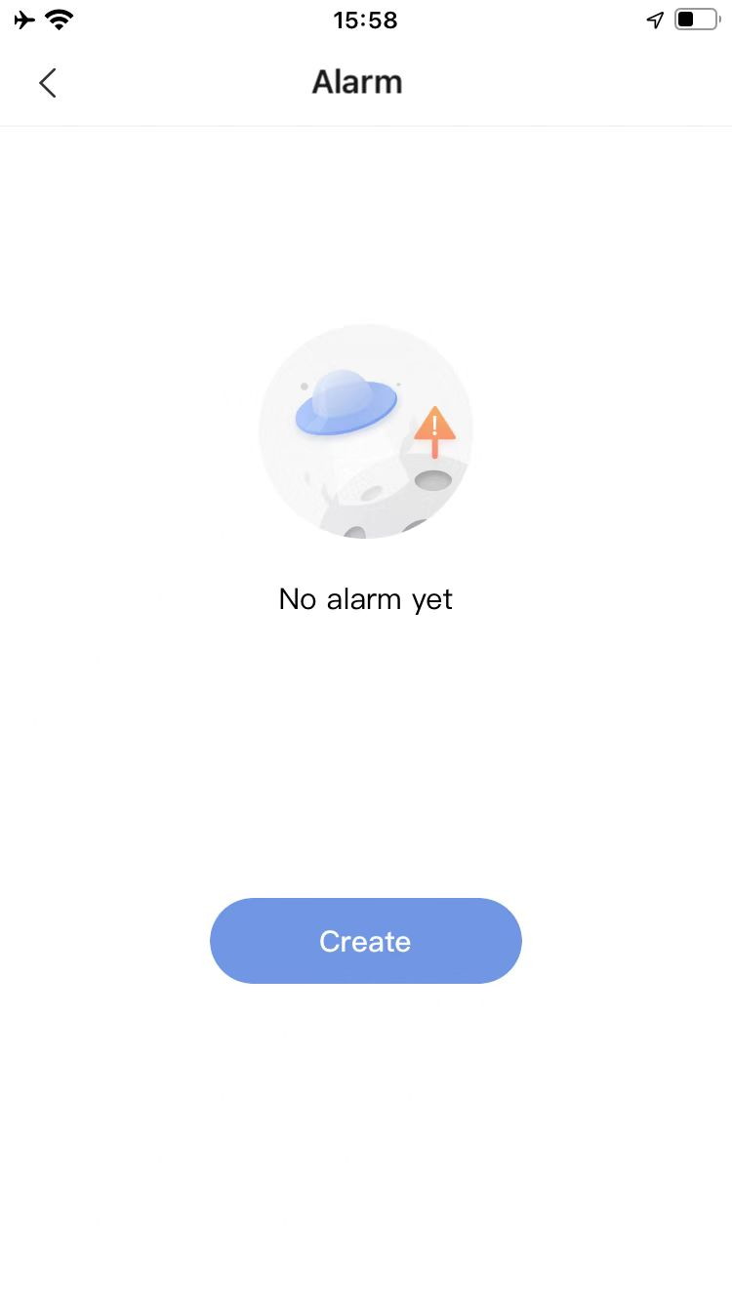
Click “Create”.
How to Enable Alarm Notification on Homepage
Main step 1: Select the condition
Click “Homepage Card”.
Select “Human body sensor” or “Illuminance”.
Click “alarm”.
2
1
3
3

Slide 20
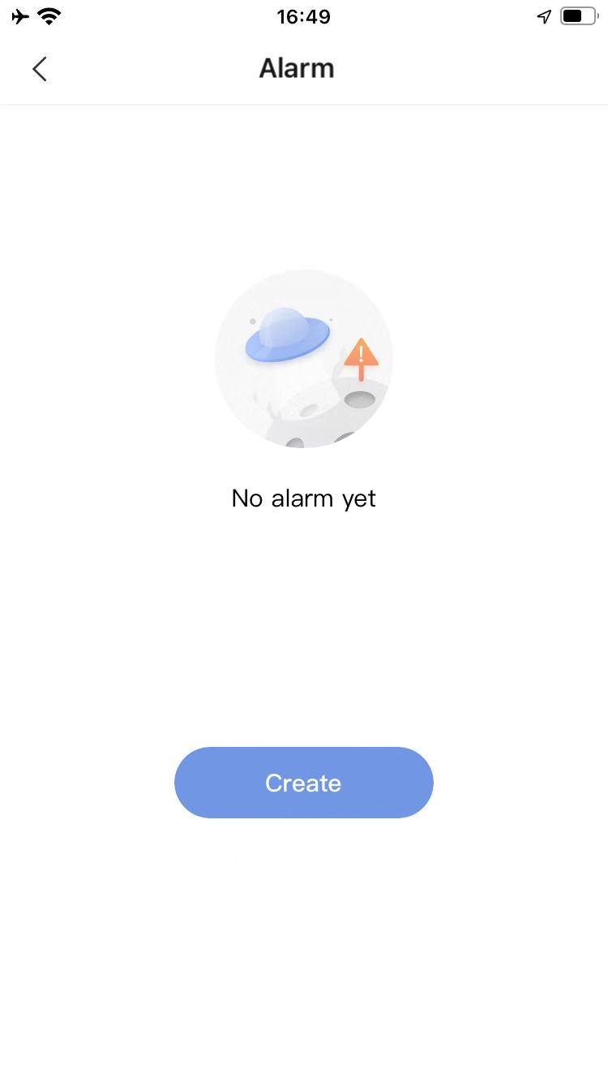
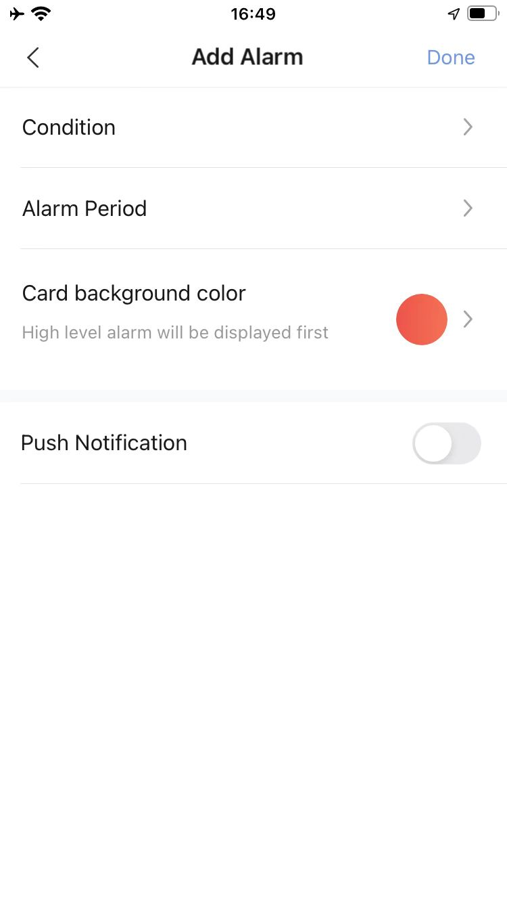
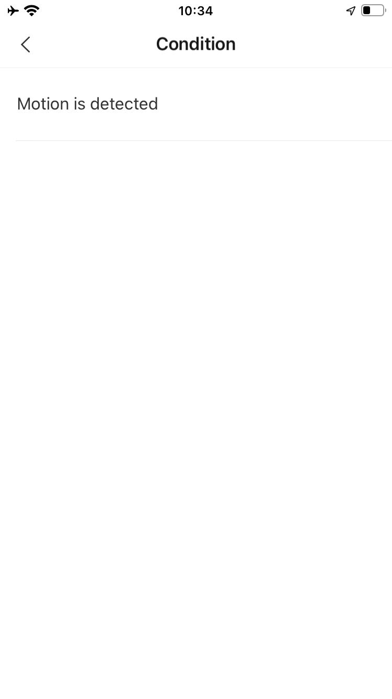
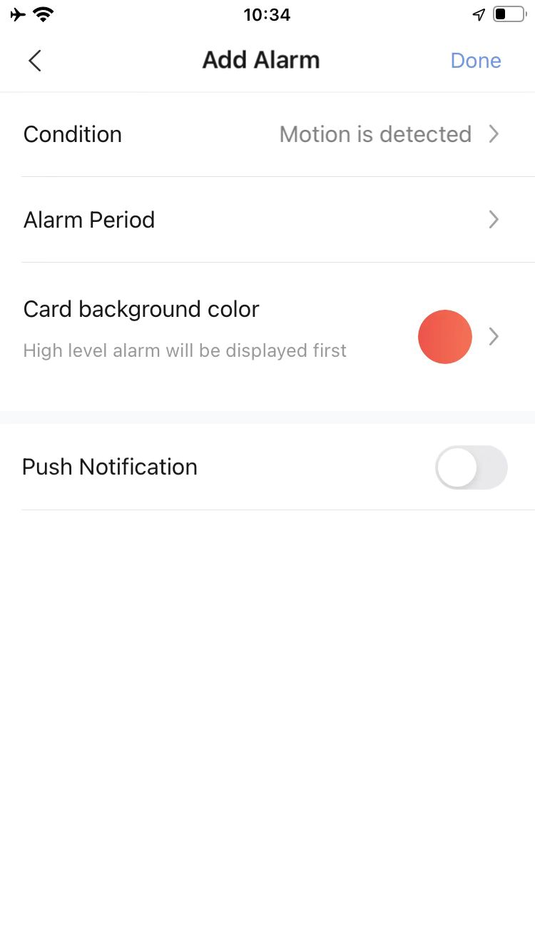
How to Enable Alarm Notification on Homepage
Click “Create”.
Click “Condition”.
Select the condition.
Check the condition.
5
6
4

Slide 21
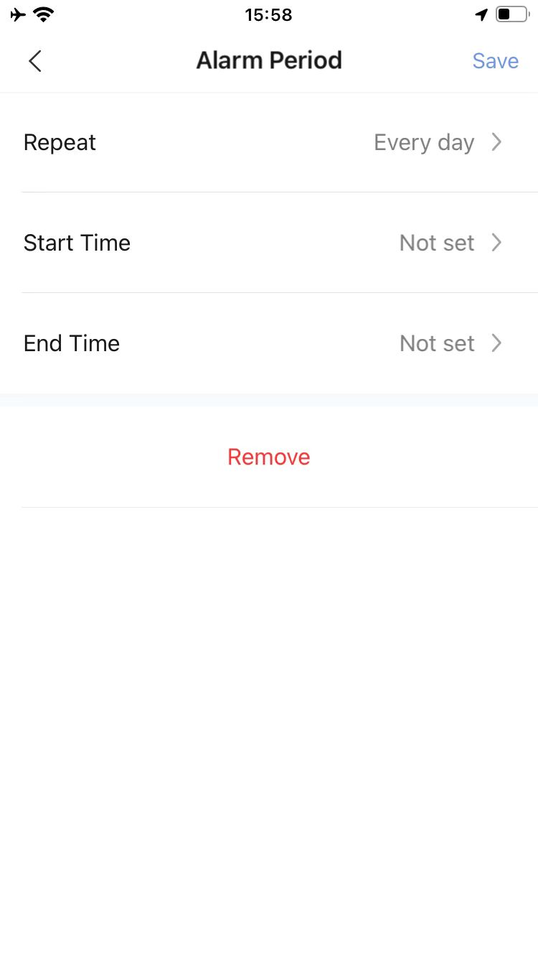
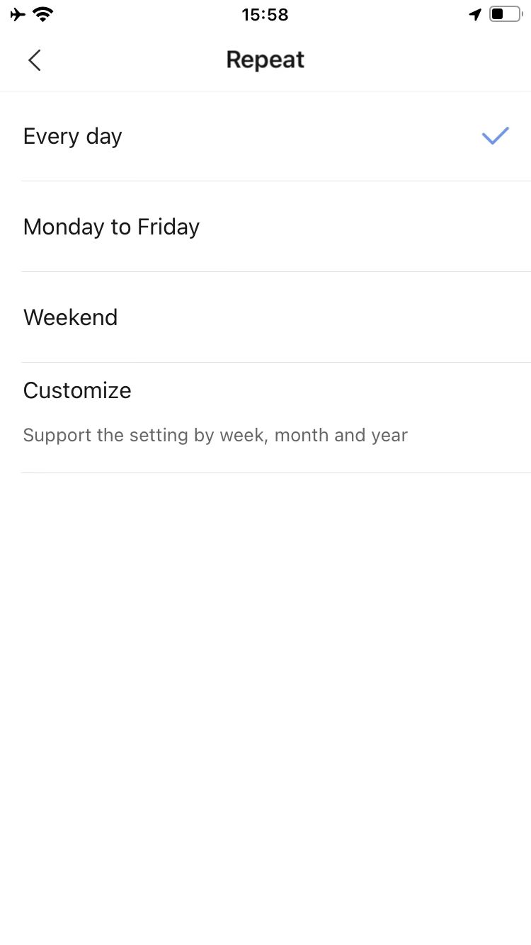
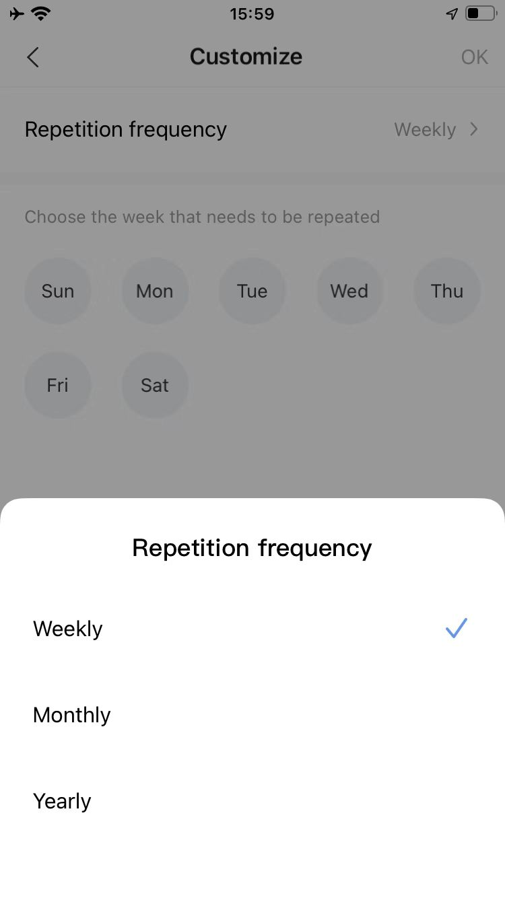
How to Enable Alarm Notification on Homepage
Main step 2: Select & set the “Alarm Period”
Click “Alarm Period”.
Click “Repeat”. And set “Start Time” and “End Time”
Select the period from the list or customize it.
Customize as per the requirement
2
1
3
4

Slide 22
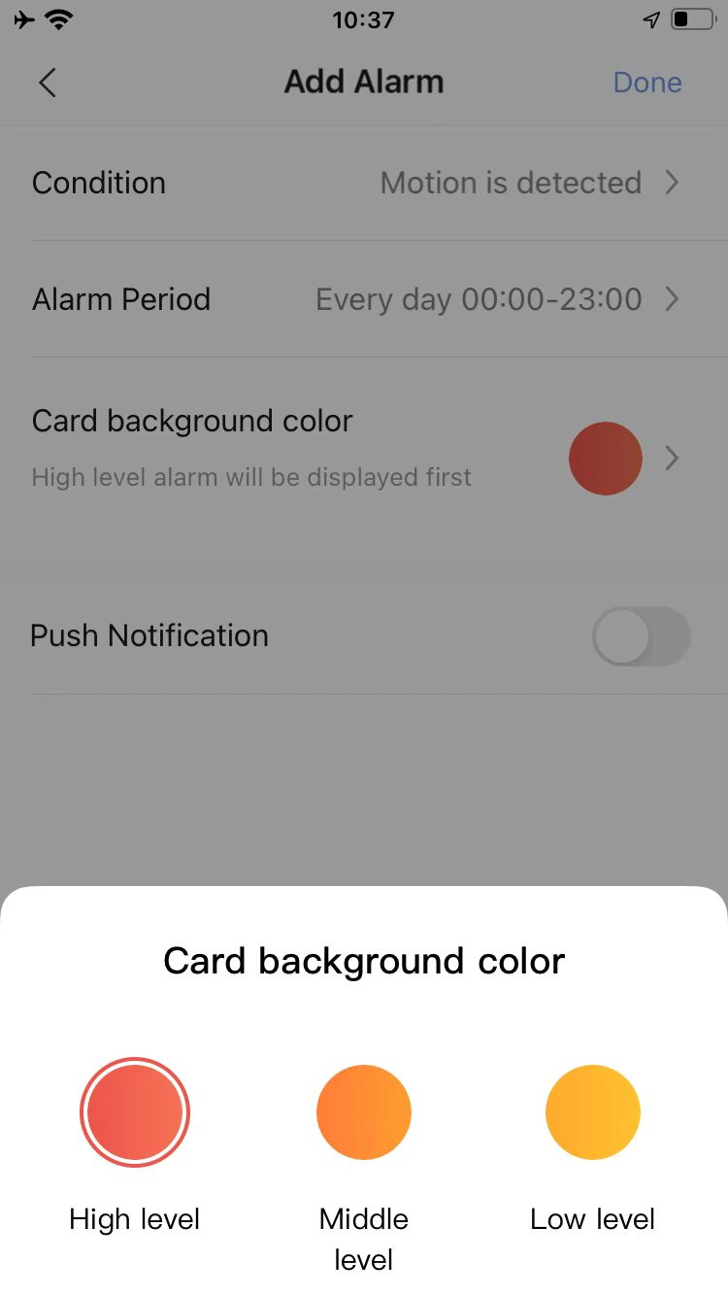
How to Enable Alarm Notification on Homepage
Main step 3: Select “Card background color”
1
2

Slide 23
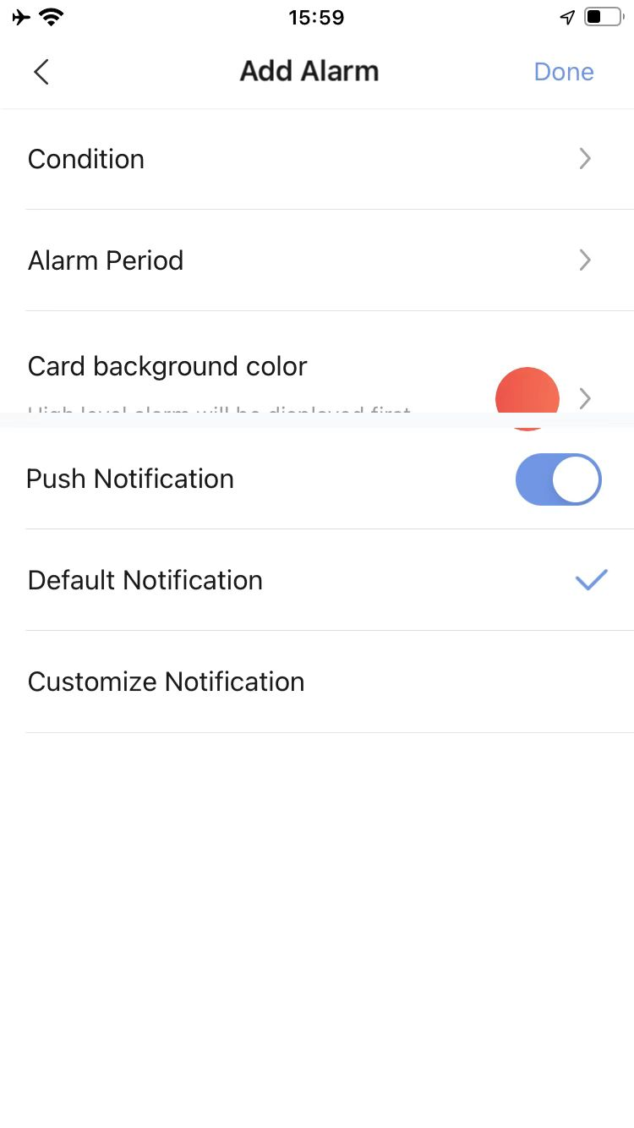
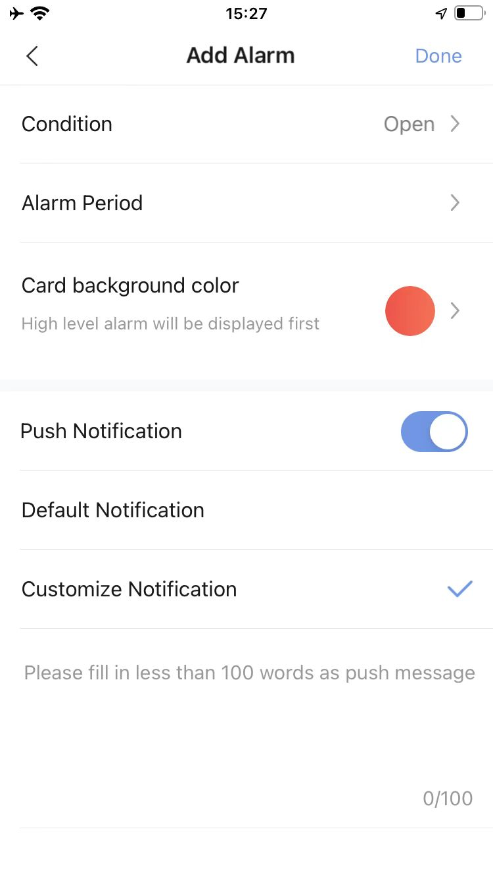
How to Enable Alarm Notification on Homepage
Main step 4: Select or customize “Push Notification”
Configure default notification, please follow the step 1--step 2--step 3.
Configure customized notification, please follow the step 4--step 5--step 6.
3
6
1
2
4
5

Slide 24
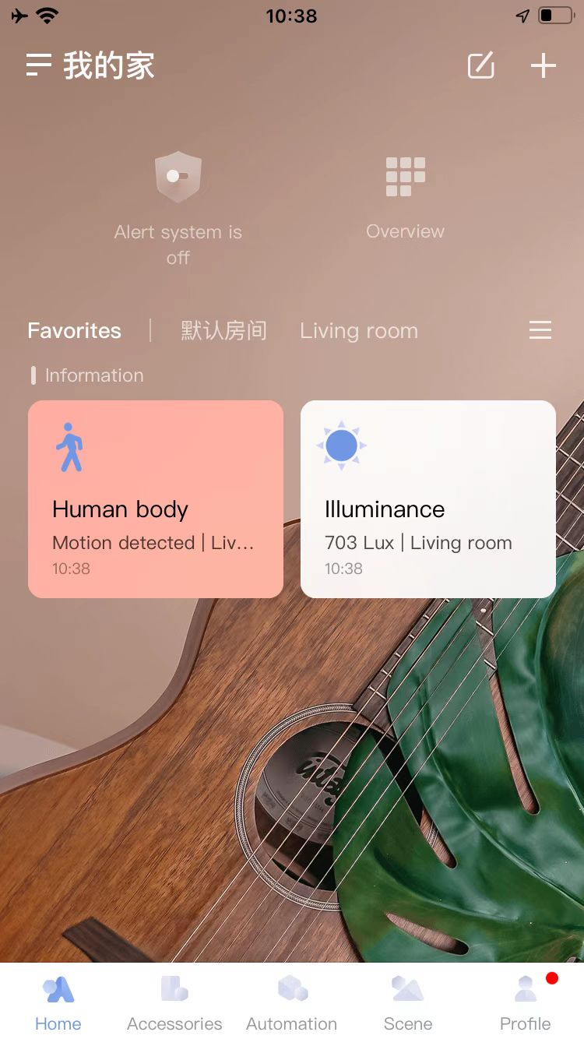
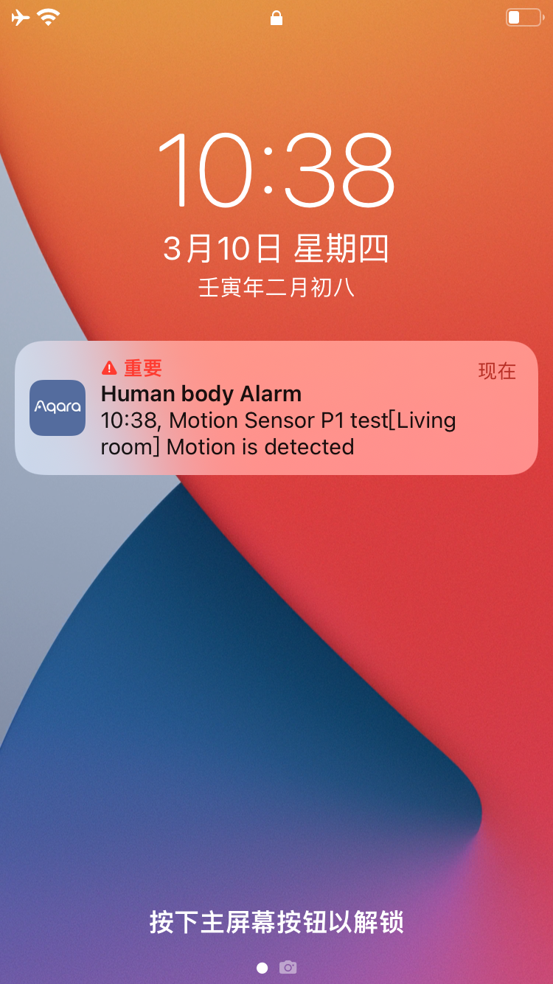
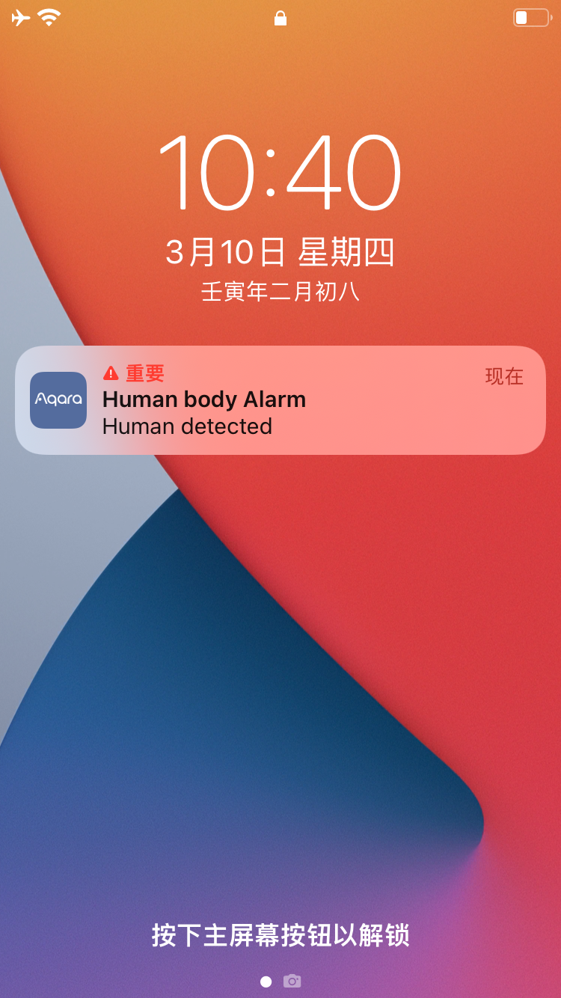
How to Enable Alarm Notification on Homepage
Main step 5: Check the “Alarm Notification” on Homepage
Go to the homepage and click “Favoriate”.
The Icon will flash as per the selected backgroud color when there is alarm.
Here is the default alarm notification.
Here is the customized alarm notification.

Slide 25
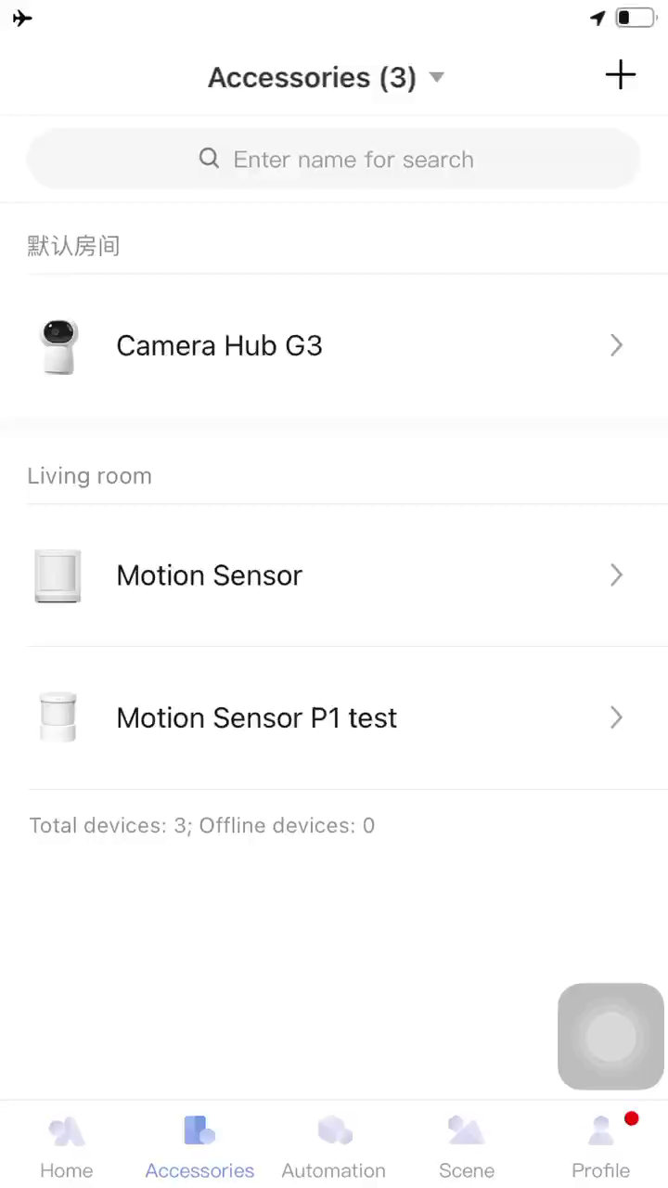
How to Identify the Device
Single press the reset button.
Check the device at the “Accessories” Page. The device will flash on App.
1
Single press reset button
2

Slide 26
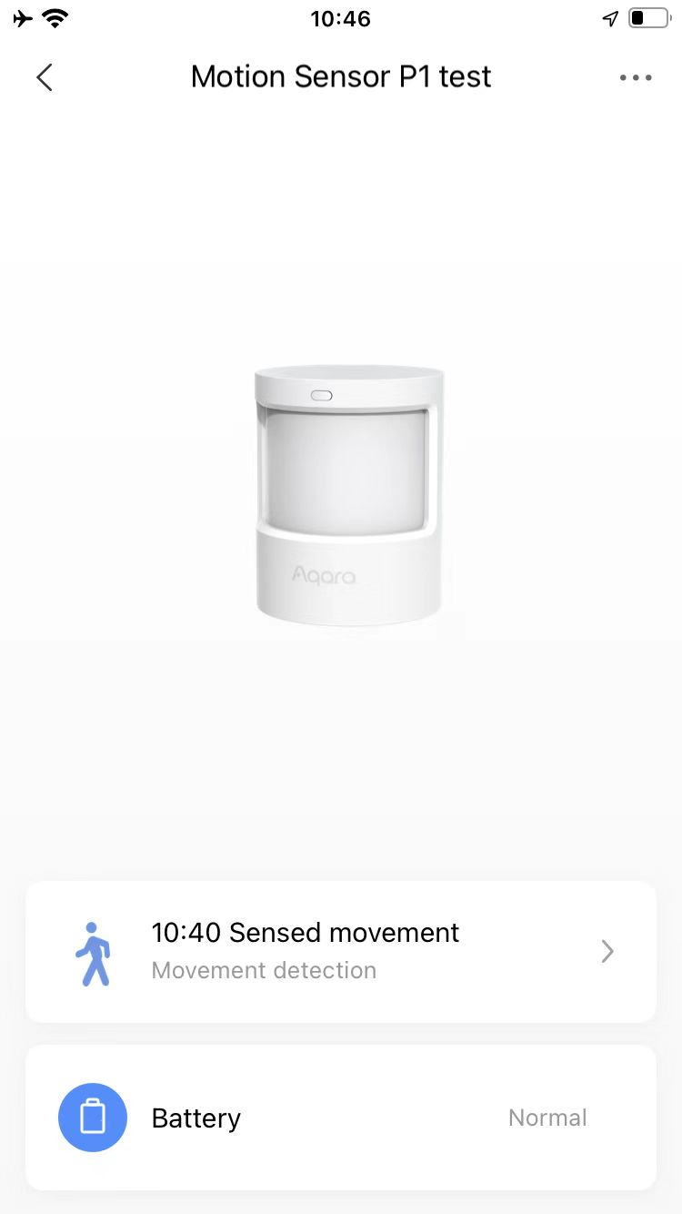
How to Battery Level
Click “Motion sensor P1”.
Check the battery.
1
2

Slide 27
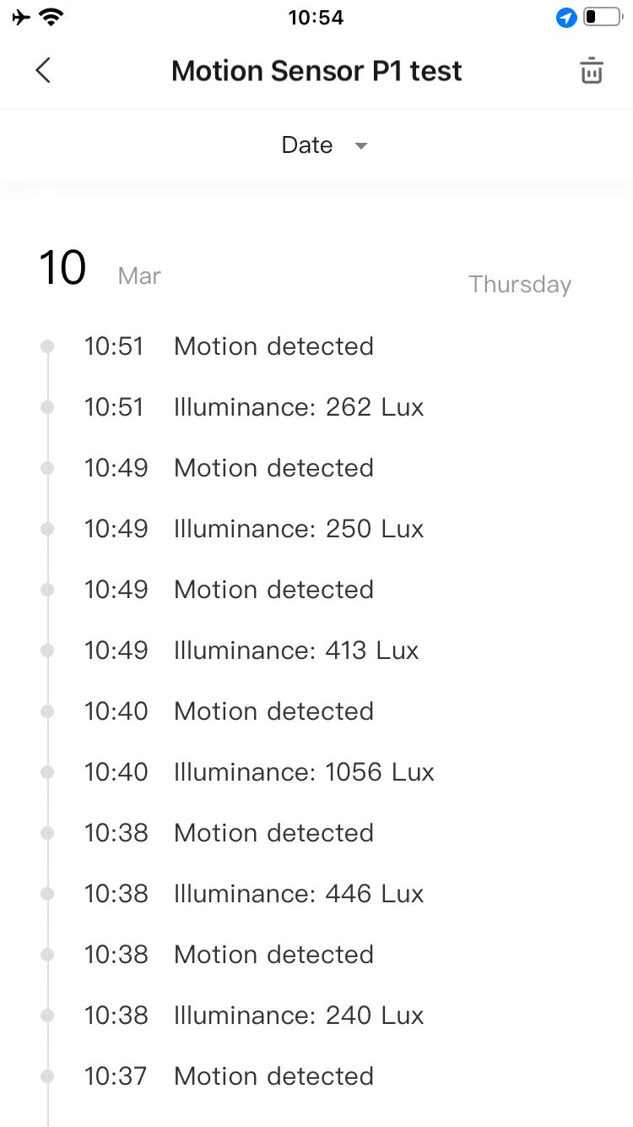
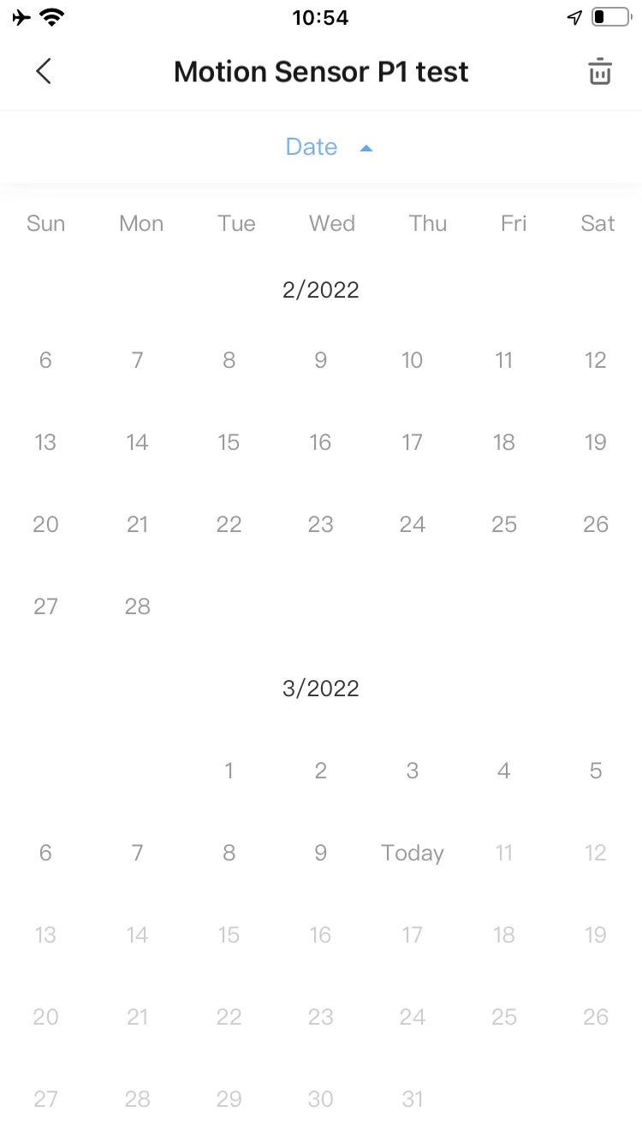
How to Check Logs
Click “Logs” when enter “Motion sensor”.
Select the date.
2
1

Slide 28
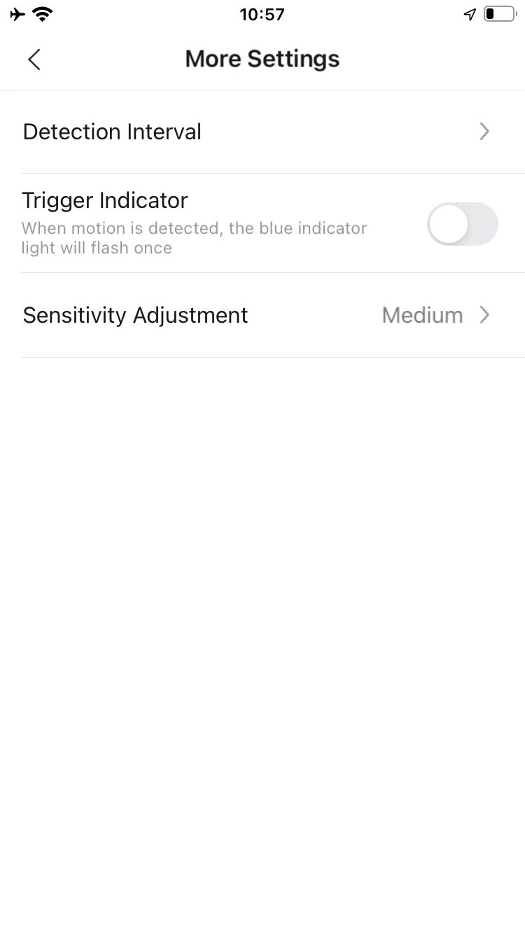
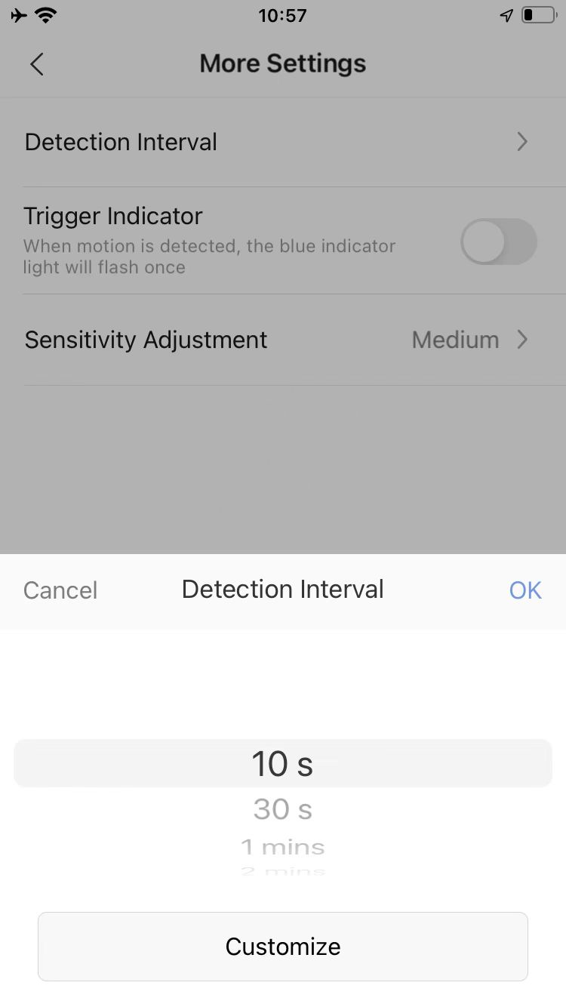
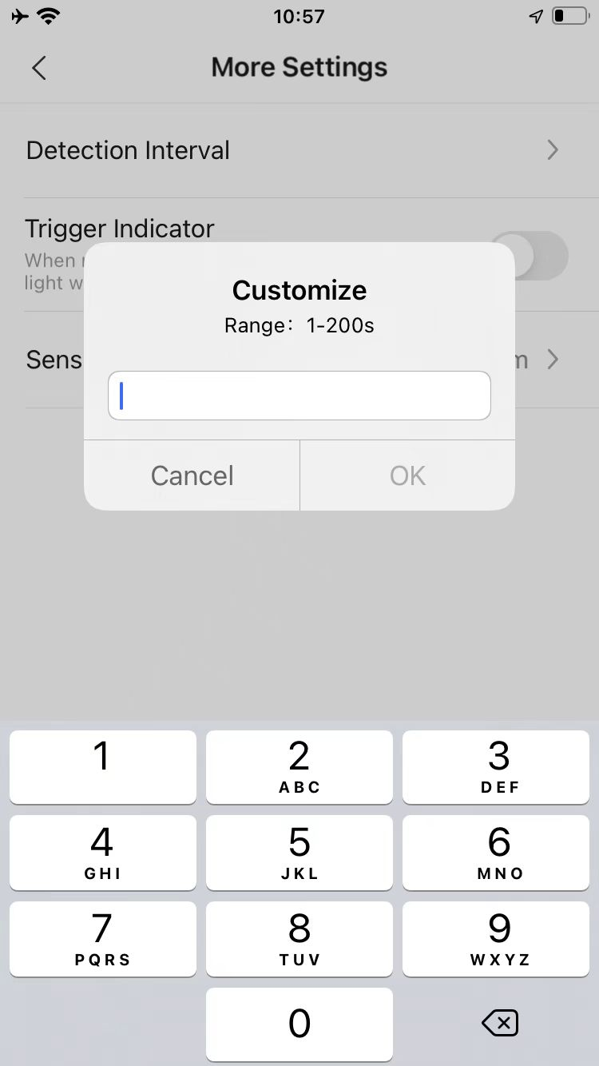
How to Set Detection Interval
Click “More Settings” .
Click “Detection Interval” .
Select from the list or customize the interval.
Input the value of interval between 1-200s if select customize the interval
2
5
1
3
4

Slide 29
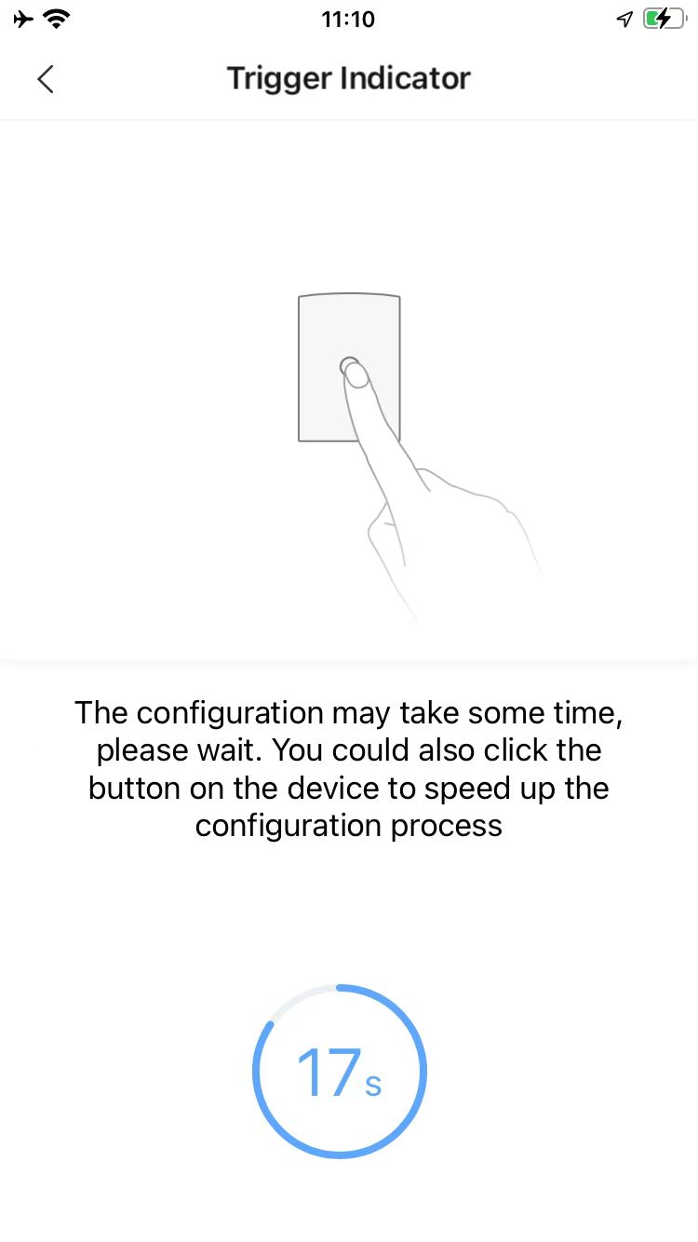
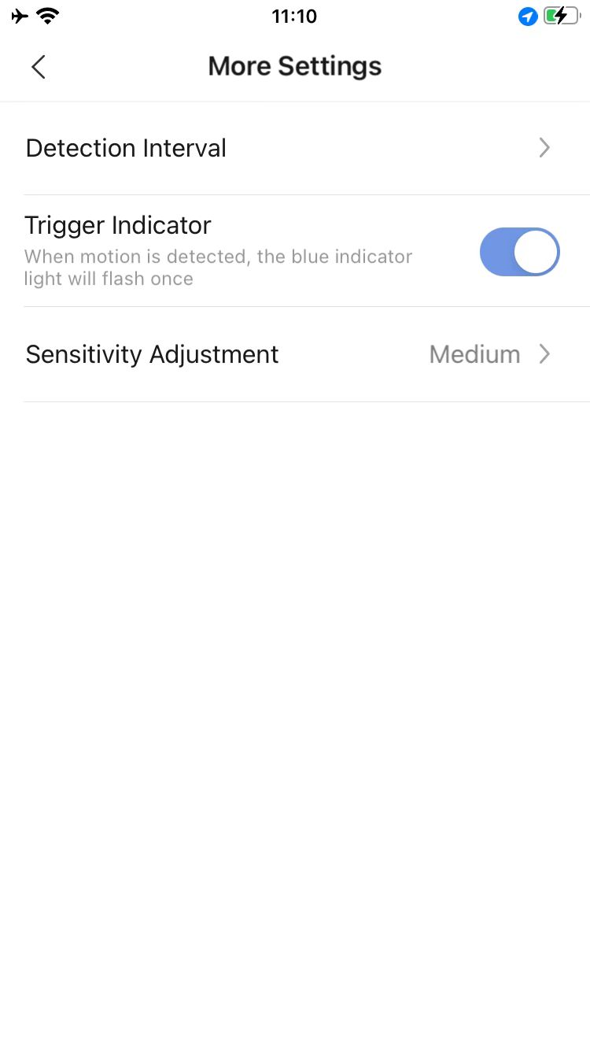
How to Trigger Indicator
Click “More Settings” .
Enable “Trigger Indicator” .
Single press the reset button on the sensor.
Then the indicator function is on.
4
2
1
3

Slide 30
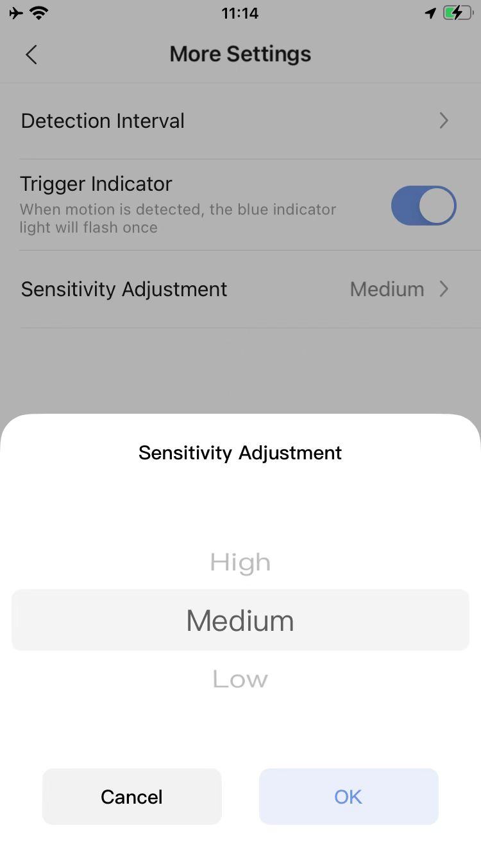
How to Change Sensitivity
Click “More Settings” .
Click “Sensitivity Adjustment” .
Select sensitivity from the list. The default setting is medium.
2
1
10 meters distance
3
7 meters distance
5 meters distance
4

Slide 31
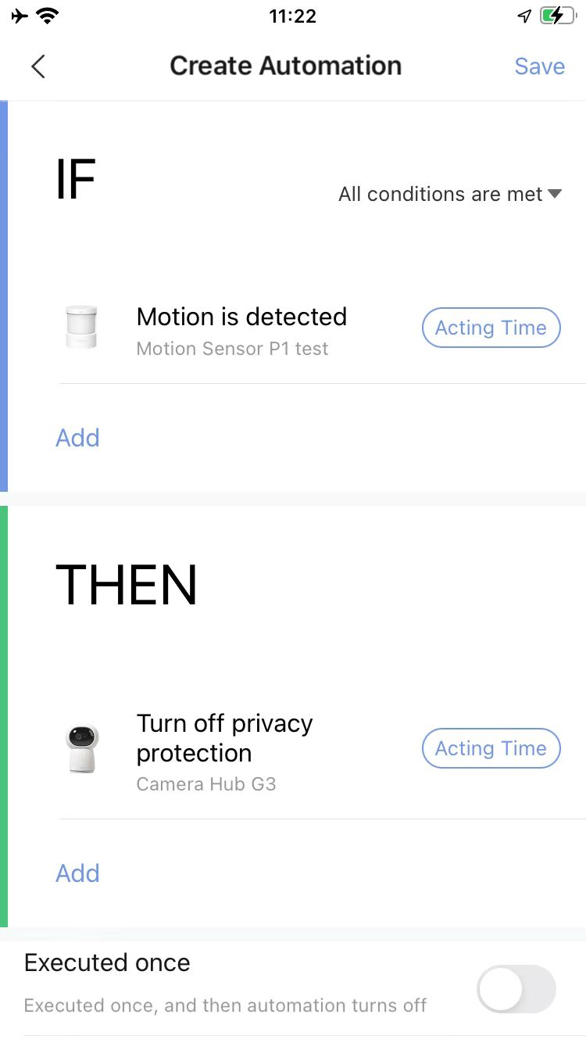
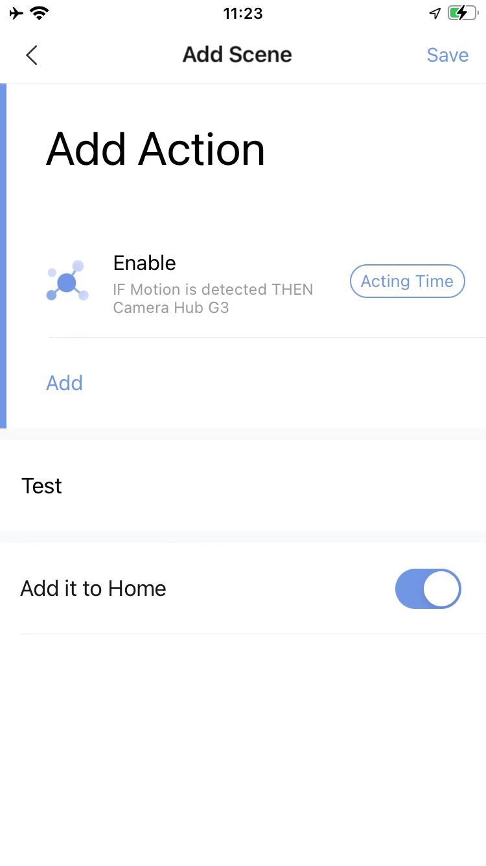
How to Configure Automation and Scene
Aqara Motion Sensor P1 supports the below Automation on Aqara Home App.
Please click “Automation” and “Scene” to start the configuration, below are the main steps on App.
IF:
Motion is detected
Motion is detected and brightness is above
Motion is detected and brightness is below
No motion has been detected in over
Automation configuration
Scene configuration
Then:
Not support

Slide 32
Content
Product introduction
Product installation
Configuration on App
FAQ

Slide 33
FAQ for Motion Sensor P1
Where should the Aqara Motion Sensor P1 be installed and how do I install them?
1. Install in the area that needs to be monitored, for example in the living room or bedroom (during installation, please refer to the detection range in the quick start guide).
2. A coffee table, shoe cabinet or desk can be used, but ensure that it is installed close to the edge (recommended height is 1.2m/3.94ft to 2.0m/6.56ft);
3. Do not place it on a metal surface or allow something to block the motion sensor P1.
What should I pay attention to when I install the Motion Sensor P1?
1. Do not install the sensor on tile, glass, marble and other smooth and moist surfaces, so that the adhesive will not come off.
2. Do not install the sensor on the surface of high-temperature and heat objects such as lighting tubes, so that the adhesive will not come off.
3. Do not install the sensor on rough and uneven surfaces such as wall coverings, so that the adhesive will not come off.
4. Do not put the senor towards hot objects such as electrical appliances when installing to avoid false triggering caused by infrared interference.
How to reset the motion sensor P1? When should it be reset?
1. Press the reset button on the accessory for 5 seconds. The indicator will flash 3 times before resetting to factory defaults.
2. If a connected sensor needs to be connected to another Hub, it has to be reset first.
Why does the Aqara Motion Sensor P1 fail to connect? How to reconnect?
Possible reasons:
1. Operation error. Please add the accessory according to Add Accessory method again.
2. The accessory is too far away from the Hub. Please move the accessory closer to the Hub.
3. There are more than 32 accessories under this Hub.
Why does the blue light flash once when someone is detected passing by?
1. The Motion Sensor P1 will flash blue once when it detects motion within the first 5 minutes after joining the network.
2. When the "trigger indicator" is set, a blue light will flash once when motion is detected.

Slide 34
FAQ for Motion Sensor P1
When the reset button of Motion Sensor P1 is pressed, why does the indicator flash?
Low battery
If a pet enters the detection area of the Aqara Motion Sensor P1, will it trigger the sensor?
Yes. If you do not want a pet to trigger the sensor. Please refer to the detection diagram in the quick start guide and place the motion sensor P1 in a higher location. This way, a pet will not trigger the sensor when it moves on the floor. (Please refer to the quick start guide regarding the installation options).
Why does the device report motion detected when no one is passing?
1. There may be some objects with heat in the detection area of the Motion Sensor P1, which interfere with infrared detection.
2. Hot and cold air flow with a large temperature difference may appear in the detection area of the Motion Sensor P1.
How to identify if the Aqara Motion Sensor P1 works properly?
Click the reset button of the Motion Sensor P1. If the Hub makes voice prompts, "Normal link confirmed", it indicates that the Hub and the Motion Sensor communicates properly; If there is no voice prompt, please move the sensor closer to the Hub and try again. If there is still no voice prompt, the sensor might be deleted or it might run out of battery. Please refer to the accessory adding methods to add the accessory or replace the battery.
Under what conditions does the Aqara Motion Sensor P1 go offline frequently?
Possible reasons:
1. The accessory is too far away from the Hub, please try to install the accessory closer to the Hub.
2. Low battery or dead battery. Please replace the battery.
3. The accessory is installed on the metal surface and the signal is interfered. Please avoid metal surface.
Why does my Aqara Motion Sensor P1 not respond but the light flashes normally when I press the reset button is pressed?
Possible causes:
1. PIR probe or lens has been damaged;
2. The device is in the trigger interval;
3. The device is offline, please confirm whether the device and the hub are connected properly.

Slide 35
Thank you

